Slide 1

Grant Writing
Process
Workshop

Slide 2
The Grant Writing Process
Covers a broad scope of activities including planning and research, proposal development, and proposal follow-up.
Grant writing is 80% planning and only 20% writing.

Slide 3
A grant is:
A giving of funds for a specific purpose
A relationship between grantor and grantee is an exchange relationship
The exchange varies with the type of grant making organization
It is not gift or charity

Slide 4
Two common questions that are commonly asked by grant seekers
1. “Where is the money available?”
2. “How do I seek funding?”

Slide 5
There are 2 primary sources of grant money
Public Private

Slide 6
Examples of Public Grants
Research grants: support investigation of the discovery of facts or application of new theories
Demonstration grants: to demonstrate or establish the feasibility of a particular theory
Project grants: support individual projects in accordance with legislation
Block grants: provide states with funding for a particular purpose
Formula grants: provide funding to specific grantees on the basis of a particular formula

Slide 7
Public Funds
Obtained from governmental units like federal, state, and local agencies.
Many of the health grant programs administered by the federal government are based on the pursuit of national objectives.
Notes:
Government grants are typically: Detailed; Usually competitive; Specific detailed instructions; No cover letter; Specific evaluation criteria; and Typical steps include: program planning, funding research, getting the last RFP, getting previous successful proposals, talking to project officer with questions, attending technical assistance workshops, and following instructions.

Slide 8
Private Funding
Can be obtained from a variety of sources, such as foundations, corporations, voluntary agencies, and community groups.
Private Foundations
  receive income from individual, family, or groups of individuals
  funding priorities are usually based on personal philosophies of the founding member
    Example:
      Robert Wood Johnson Foundation
      W.K. Kellogg Foundation
Notes:
Corporations and Foundations grants are typically: Shorter; Less detail; Credibility is key!; Cover letter; and Typical steps include: program planning, funding research, reading the annual report or 990, reading website. Read everything. Talk to past recipients- if staffed, the program officer, if unstaffed, the Board.

Slide 9
Private Funding
Corporate Foundations
  receive contributions from profit-making entities
  Over 2,000 in U.S. with assets over $11 billion
  Example: CIGNA, Walmart
Community Foundations
  are involved in grant giving within a specific community, state, or region
  Example: Otto Bremer Foundation, Dakota Medical Foundation, ND Community Foundation

Slide 10

Seeking the Appropriate Funding Source

Slide 11


What is RHIhub?
Online library focused on rural health and human services.
Over 13,000 rural relevant resources, including:
  Funding opportunities
  Over 60 topic guides
  State pages
  News
  Reports and publications
  Events calendar
  Maps
6 million visitors to our website
8,700 requests
Notes:
RHIhub is an online library focused on rural health and human services. We have over 13,000 rural relevant resources in our library. These resources include funding opportunities, 60 topic guides, state pages, news, reports and publications, an events calendar, and maps.
In the 13 years of RHIhub’s (formerly RAC) existence, we have had nearly 6 million visitors to our website and have answered over 8,700 requests. (Badlands picture)

Slide 12

What RHIhub Does…
Help rural communities access the full range of available programs, funding, and research
Provide easy access to information gathered from many sources
https://www.ruralhealthinfo.org/
Notes:
“Clearinghouse for all things rural when it comes to healthcare”
The vision of RHIhub has always been to help rural communities navigate and access all of the resources that are available to them, both within the federal government and elsewhere.
We do that by gathering information from hundreds of organizations and agencies across the country and organizing that information so it can easily be found and used by those who need it.
#1 thing they are contacted about is funding.

Slide 13
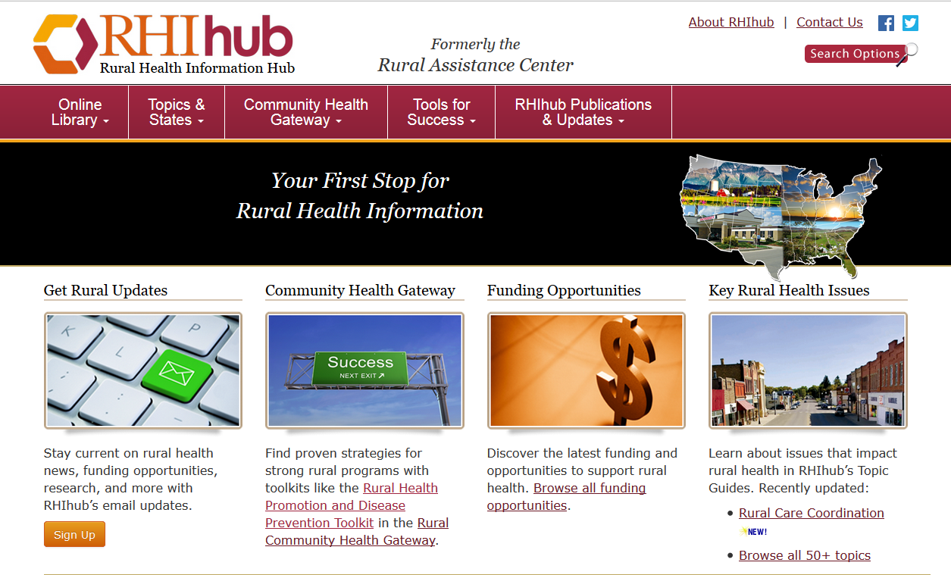
Notes:
News headlines
New in Online library
The Rural Monitor – Standing the Test of Time: Sustainability Planning
Community Health Gateway – proven strategies for successful rural programs with toolkits

Slide 14
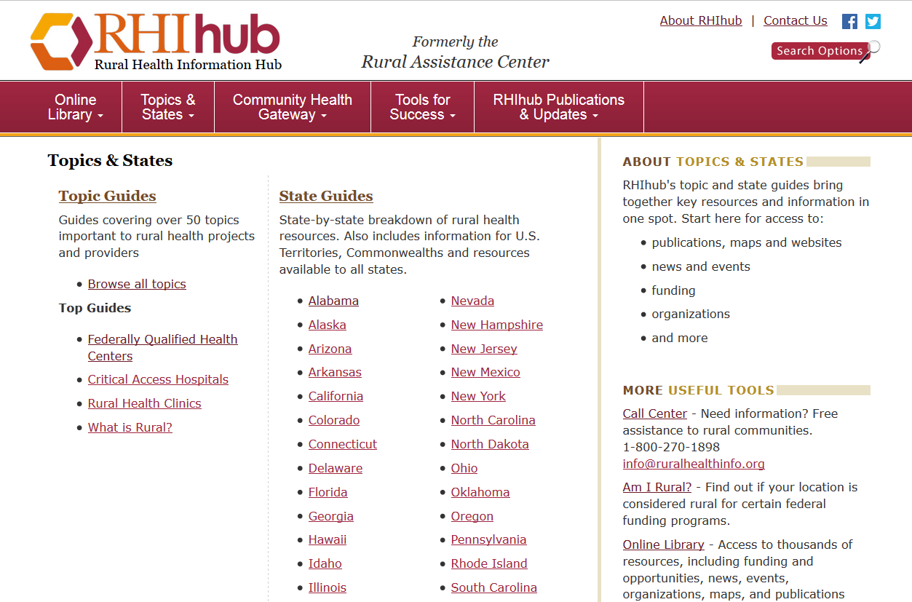
Finding Rural Data to Support Proposals

Slide 15
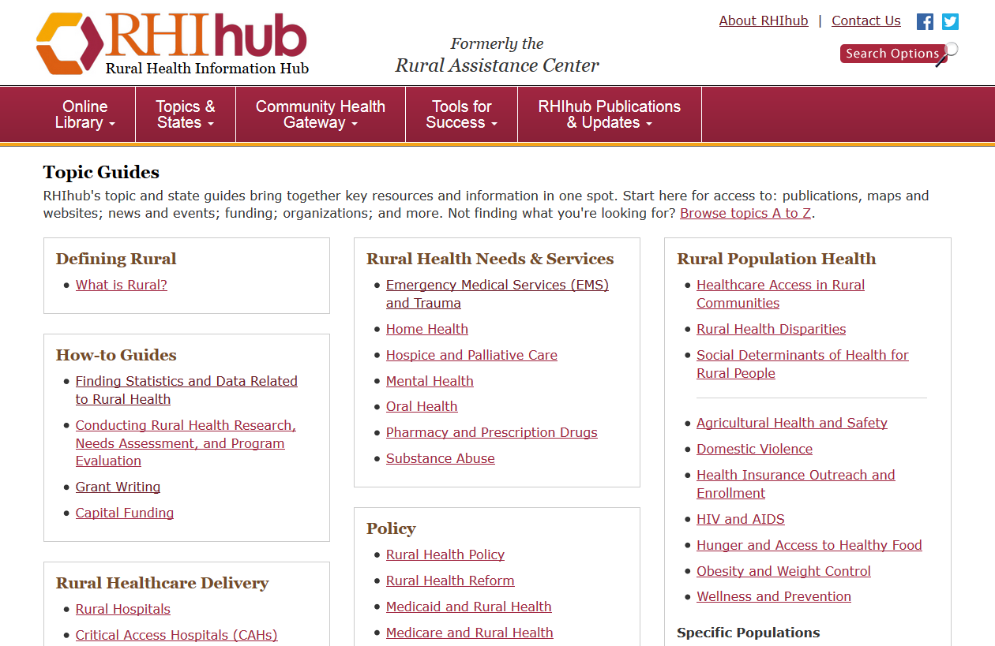
Topic Guides
Over 50 Topics
On Rural Health Issues

Slide 16

Customized Assistance
info@ruralhealthinfo.org
1-800-270-1898
Tailored Searches of Funding Sources for Your Project
Foundation Directory Search
FREE
Service!

Slide 17
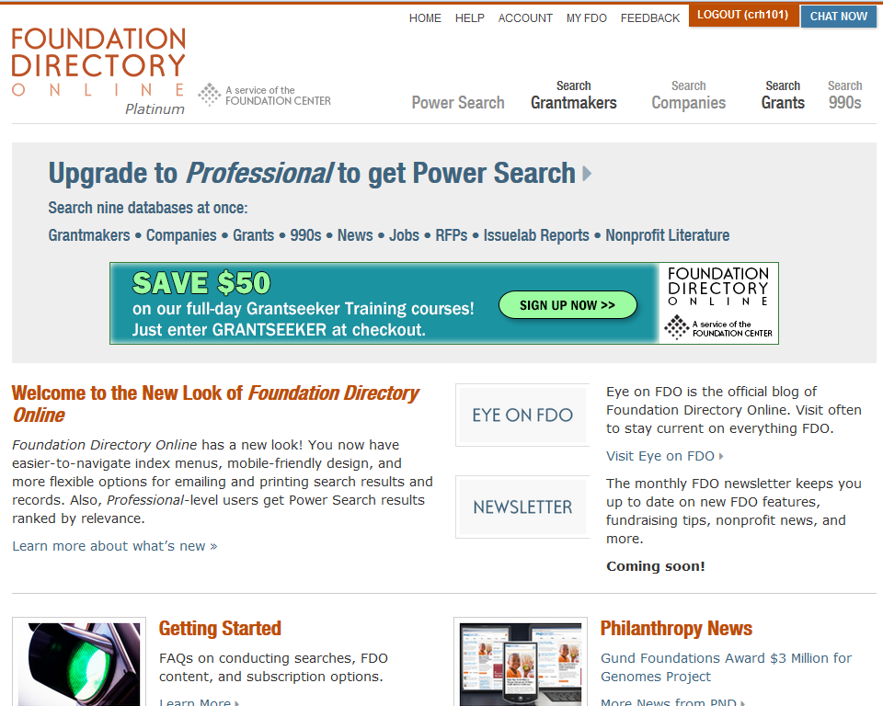
Foundation Directory Online
https://fconline.foundationcenter.org/
Notes:
The Foundation Directory Online is a subscription-based online database of over 120,000 grantmakers. The current number of funding programs directly related to rural health care is listed at just under 3,000. They also have a complete database of 1099 forms, which I will talk about a little more in detail later.
It has national, state and regional-level funders, and foundations that only operate in local communities or counties.
Subscriptions start at $19.99 a month and go up to $179 a month. I mentioned the customized assistance the Rural Assistance Center can provide before, and am going to bring it back up again. If you don’t want to pay for a subscription to Foundation Center, you can call RHIhub and we will do a free search. Most of info specialists have Masters of Library Sciences and are trained in how to pull out the best information from large databases like the Foundation Center using keywords and search terms, so they can save you a lot of time.
What You Can Find:
National Funders
State and Regional Funders
Local Funders
1099 Forms
You can also locate your nearest Funding Information Network library. There are hundreds of them across the U.S. and they have access to the Foundation Directory Online, as well as print resources for grant writing support.
Can also access free of charge at the public libraries in Fargo and Minot.

Slide 18

Creating a Planning Process

Slide 19
Step 1 - Define your project
  Clarify the purpose of your project and write a mission statement.
  Define the scope of work to focus your funding search.
  Determine the broad project goals, then identify the specific objectives that define how you will focus the work to accomplish those goals.
Source: Corporation of Public Broadcasting - www.ncat.edu

Slide 20
Step 1 (cont)
  Decide who will benefit.
  Draft expected project outcomes in measurable terms.
  Create a timeline that includes the planning phase, the period of searching for funds, proposal writing, and the intended project start date.
Notes:
Benefits may extend beyond the direct beneficiary to include the audience, other institutions, etc.
Periodically update the timeline as you learn more about submission deadlines, award timetables, etc.

Slide 21
Step 2 - Identify the right funding sources
  Do not limit your funding search to one source.
  Look for a match between your project and the grants you seek by looking for consistency between the purpose and goals of your project and the funder
Source: Corporation of Public Broadcasting - www.ncat.edu
Notes:
Foundation centers, computerized databases, publications, and public libraries are some of the resources available to assist your funding search.

Slide 22
  Step 3 - Make direct contact with funders who support projects like yours
    Think of the funder as a resource.
    Identify a project officer who will address your questions.
    Ask for technical assistance, including a review of proposal drafts. Some funders offer technical assistance, others do not.
  Source: Corporation of Public Broadcasting - www.ncat.edu

Slide 23
Step 4 - Acquire proposal guidelines
  Guidelines tell you about:
    submission deadlines
    eligibility
    proposal format
    review timetable
    budgets
    funding goals and priorities
  Source: Corporation of Public Broadcasting - www.ncat.edu
Notes:
Proposal format: award levels forms, margins, spacing, evaluation process and restrictions on the number criteria of pages, etc.

Slide 24
Step 4 (cont)
    award levels
    evaluation process and criteria
    whom to contact
    other submission requirements
  Additionally: Read the guidelines carefully, then read them again.
  Ask the funder to clarify your questions.

Slide 25
Step 5 - Know the submission deadline
  Plan to submit your proposal on or preferably before the deadline.
  Be realistic about whether you have time to prepare a competitive proposal that meets the deadline.
  Know the funder's policies on late submissions, exceptions, and mail delays.
  Find out how the funder will notify you about the receipt and status of your proposal.
  Source: Corporation of Public Broadcasting - www.ncat.edu

Slide 26
Step 6 - Determine personnel needs
  Identify required personnel both by function and, if possible, by name.
  Contact project consultants, trainers, and other auxiliary personnel to seek availability, acquire permission to include them in the project, and negotiate compensation.
  Personnel compensation is important budget information.
  Source: Corporation of Public Broadcasting - www.ncat.edu

Slide 27
Step 7 - Update your timeline
  Factor into your schedule time to write multiple drafts, gather relevant and permissible materials, and prepare an impartial critique of your proposal for clarity, substance, and form.
  Source: Corporation of Public Broadcasting - www.ncat.edu

Slide 28
Planning Raises Essential Questions
What is the problem?
What do we want to do about it?
How do we want to do it?
Who is going to do it?
How much will it cost?
When/Where will it occur?
How does the proposal fit our mission?
Who will be involved in writing the grant?
Who will be administering the grant?
Notes:
These sound like very elementary questions, and they are; however, if you cannot provide a funder with answers to these questions – you won’t be funded.
Establish the community need, not your organization’s need. The lack of a program is not the problem.

Slide 29

WRITING & DEVELOPMENT TIPS

Slide 30
Writing and Development Tips
Read directions carefully
  Read, Read, and re-read
Develop an outline of each required component
Proposal should look like one person wrote it, even if done by a committee (have an editor)
One person should be responsible for coordinating proposal planning and development
Show that funding the proposal will benefit many -- social benefit
Notes:
The guidance is your best friend.
Use the language that is in the guidance.

Slide 31
Writing and Development Tips
Remember others
  Talk to others who have written grants – their experience, lessons learned
  Try to locate people who have been funded by organizations you plan to submit a proposal
  UND Center for Rural Health, Kalisi ‘Ulu’ave, most importantly - talk to the funder!
  Associations and other regional or state organizations
  RHIhub

Slide 32
Writing and Development Tips
Remember your audience: The Reviewer
  Typically doesn’t know anything about your situation, your community, or even your state
  Explain basic facts
  Rural and frontier as a concept (distance, weather, roads); culture; and your unique circumstances
  Central goal: convince reviewer of the legitimacy of your problem, your solution, your ability
Notes:
Have to sell them
You used a legitimate process to identify and substantiate the problem (data and statistics)
You tapped into others in the community not just a special few – sources of support
Show how the problem impacts broad range of people
Show the benefit to society, the community (not your facility)
Your solution (the proposal) is practical, logical, efficient, effective, will produce desired outcomes
You have specific and achievable goals, objectives, time lines and it is measurable
YOU HAVE WHAT IT TAKES
Plans for sustainability
Evaluation

Slide 33
Writing and Development Tips
Remember Your Audience: The Reviewer
  MUST MAKE IT EASY FOR THE REVIEWER
  Don’t deviate from the guidance
    they set the order of sections and the titles
    they set the rules
    they have the money
  Be detailed (even to the point of being elementary)
  Be concise (less words the better)
Notes:
This is key: it really isn’t about you, it is about them

Slide 34
Writing and Development Tips
  Remember Your Audience: Reviewer
    Put yourself in the funding source’s shoes
    Ask yourself same questions that a skeptical reader would ask:
      Why should anyone bother to read this?
      Why should they care?
      What difference is this going to make?
    Present it in layperson’s words -- program officer may not be an expert in your field and they have to explain the proposal to others
Notes:
Funders actually want to give you money – it really is there job, but they have to select the best, best idea, solution, greatest need – they don’t have to give the funds to you but you have to convince them that you are a good risk, you are an investment for their foundation or funds
It all goes back to your credibility, your argument, your expertise, your ability
This is hard because you know what you can do but they don’t – you have to convince them you are worth it.

Slide 35
Writing and Development Tips
  Remember Your Audience: Reviewer
    Show that it impacts real people
    Emphasize collaborative nature of process and outcome
    Show how you included target audience in planning stage
    Find a hook, novel way of looking at the situation and show promise
    Show prospect of replication
    Show plan for sustainability and continuation – essential!
Notes:
How does it benefit the community? The target audience?
Funders generally like to see some level of collaboration (shows ability to work together for the common good, shows efficiency, shows compatibility
Some funders require collaboration
Original solution is not essential (can be good, but must be legitimate if say it is original better show that it is)
Replication shows if it works here they can use as model and encourage others – they have added to the field of knowledge
Sustainability has become a requirement – it is good investment

Slide 36
Writing and Development Tips
Logic
  Does it make sense?
  Can a reviewer easily and quickly understand your situation
  and your solution?
  Is there a flow to the argument? Is there a flow to the solution? Is there linkage between the problem and the solution?
  Avoid being “too” intuitive
Notes:
When I review logic is the biggest issue I see is the lack of logic
Sometimes it makes sense to us because we live it, we feel it and we forget that this intuitive quality is not transferred easily on paper
Simply put----Does it make sense to the naked eye, the first read (usually you only get one read, one chance to sell it to the reviewer) – if they don’t “get it” easily they lose interest and become inpatient
As a reviewer can I quickly grasp what the problem is, do I see the relationship between the need statement and their solution – is it clear, easy to grasp. Can I understand the players, and who does what, why, and when
Is it reasonable, is the basic question
Very common in first drafts to see a disconnect between the problem and the solution
Very common that the data is not supportive of the real problem, that they dumped a bunch of demographic statistics in because easy to find but have no back up for the health issue, the real issue. Then we read the solution, the plan and we as reviewer just don’t see the connection.

Slide 37
Writing and Development Tips
Writing Style
  Develop a writing schedule -- timelines
  Allow appropriate time to write and review -- takes three times longer than we usually plan
  Use an outline
  Use note cards

Slide 38
Writing and Development Tips
Writing Style
  Keep paragraphs short -- use headings and subheadings
  Rational, documented facts -- show emotion and feeling but don’t let it dominate
  Use tables, charts, graphs – be visual
  Use bullets -- easy to read and follow -- shows logic
  Avoid abbreviations, acronyms, and jargon if you can but if
  used then EXPLAIN
    CRH – Center for Rural Health

Slide 39
Writing and Development Tips
Review and critique
  Allow time -- critical step
  Use an external reviewer
  Similar to “real” review because they know little about proposal
  Look for logic gaps
  UND Center for Rural Health (ask us to critique)

Slide 40
Writing and Development Tips
What does the funder, the reviewer look for in proposal?
  Does it fit their criteria?
  Does it make sense?
  Your credibility
  Budget is appropriate to meet goals
  Did you follow the rules?

Slide 41
Writing and Development Tips
Don’t Plagiarize!
Be sure to:
Review and update boilerplate language on a regular basis to ensure it is accurate, relevant and transparent.
Review, update, and cite any data, charts/graphs, or statistics you used in previous proposals to ensure they accurately reflect current information.
https://www.chronicle.com/article/Plagiarism-in-Grant-Proposals/136161

Slide 42
Writing and Development Tips
Always:
Use quotation marks when you copy text verbatim from a source.
Cite the original source of the idea.
Leave enough time to review your proposal before submission to ensure you haven't pasted in a paragraph without attribution.
https://www.chronicle.com/article/Plagiarism-in-Grant-Proposals/136161

Slide 43
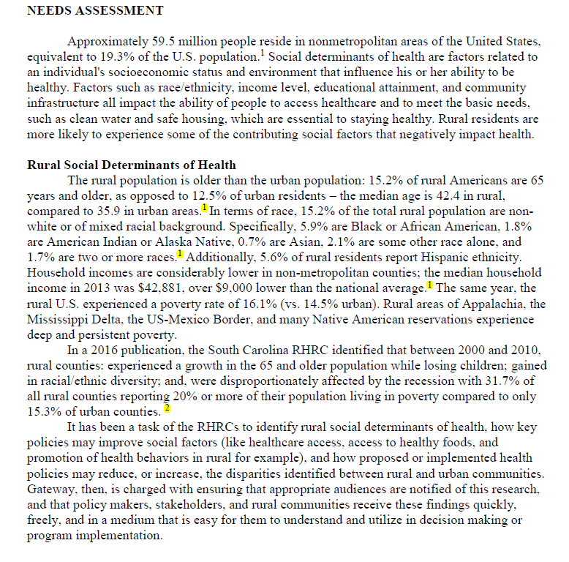
Example 1
¹ 2010 Census Summary File. United States. Prepared by the U.S. Census Bureau, 2016
² Bennett, K. Lin, Y.H., Yuen, M., Leonhirth, D., & Probst, J. (2016). Vulnerable rural counties: The changing rural landscape, 2000-2010. South Carolina Rural Health Research Center. Available at: http://rhr.sph.sc.eud/report/(13-4)Vulnerable_Rural_Counties_The_Changing_Rural_Landscape_2000-2010.pdf.

Slide 44
Example 2
Rural Communities
Rural life is frequently depicted as pastoral settings with few stresses compared to its urban counterpart (Hartley, Bird, & Depmsey, 1999; Rosenthal & Fox, 2000). In reality, farming is one of the most dangerous occupations (National Safety Council, 1998). These communities are viewed generally as cultures with social organizations where people rely heavily on one another, enjoy strong natural support among them, and are loyal to the larger community (Wenger, 1992). The strengths of rural communities include strong informal support networks, cohesiveness, established interdependence, and collaboration (Gibbens, Personal Communication May 9, 2005). Changing economies in rural areas are increasing their linkages to broader social and economic forces resulting in changing social relationships that become more impersonal. Depression and suicide is becoming an increasing problem in our rural and frontier communities. McSparron (2002) found over 42 percent of North Dakota farm operators in her study were depressed, while Linn and Husaini (1987), fifteen years earlier reported 19 percent of agricultural workers were depressed. With the continuing farm crisis, the loss of the family farm that may have been in the family for generations involves a loss of employment, home, lifestyle, and identity as well as a sense of failure increasing the risk for depression and/or suicide. Many people in rural areas experience what Rowland and Lyons (1989) call the “triple jeopardy” of being rural, poor and uninsured.

Slide 45

Writing the Proposal
Remember – It Is About the Community!

Slide 46
Proposal Sections
Cover letter
Abstract
Introduction
Needs or Problem Statement
Project description/Objectives (with Goals, Time line, and Staffing plan)
Evaluation Plan
Sustainability Plan
Budget and budget narrative
Appendices
Notes:
COVER LETTER: Generally only needed if private funder. Addressed to Chairperson of Board or anyone you have had contact with and maintained a relationship with. Summarize request and tie in key words.
ABSTRACT/SUMMARY: Describes who you are, the scope of your project, and the cost. This may be all some reviewers read, so be concise, clear and specific! It helps to write this piece after the rest of the proposal so you can easily draw from the finished portions.
INTRODUCTION: Broad overview of your organization and accomplishments. Build Credibility! Think about including: location, population/demographics, mission, staff, philosophy, vision, program, history, clients/constituency, fiscal accountability AND Evaluation results, growth numbers, demand, success stories, accomplishments, affiliations, awards/recognition, proven expertise, community support, grants, media, one-of-a-kind services, unique aspects. Don’t be too philosophy driven or overload on history. Do show organizational capability and results, and show how your experience is related to what you are trying to do in the proposal.
NEED OR PROBLEM STATEMENT: Should be people centered. Can use anecdotes or stories to illustrate the problem and add a human face to information and claims. This works well if it is a powerful incident or example that can appeal to the emotions while colorfully showing the need in concrete terms. Can also use quotes from recipients of programs.
Nature and Extent of the Problem: What is happening? To Whom? How Much? Who says? (cite your sources) Paint a picture of the population you propose to serve. Clearly define the nature and extent of the situation you propose to change. Quantify your information, because the funder could ask “so what?”
Reasons or Cause for the Problem: Why is the problem or situation occurring? How do you know? (cite your sources) There may be more than one reason for the problem. Narrow it down to the reasons your organization can address, based on your mission and capacity.
Make sure that the problem you identify and the project you propose match. Avoid identifying a problem of very general scope, then introducing a project that will address a limited part of the problem.
PROJECT DESCRIPTION/OBJECTIVES:
Objective - Specific, measurable, time-bound statement of desired results. Increase, decrease, improve, reduce, maintain. RESULT WORDS. Not to be confused with…
Approach - Establish, develop, provide, train, educate, improve access, build, demonstrate, increase numbers of people, services. ACTION WORDS.
Specify a result rather than an activity. Objectives lead to your goal attainment.
Sample Objective - Within 30 days of completion of the XYZ Training Program, 75% of the 190 participating Medicaid recipients will have access to results within 48 hours and will maintain semi-annual follow-up consults for a minimum of 2 years.
Describe activities that will take place to achieve desired outcomes/results. Tells who is doing what, to whom, where, when and why it is being done that way.
What combination of activities and strategy will you use?
Why have you selected this particular approach, out of all the possible approaches out there? -Discussing alternative methods shows you are aware of different programs in the field and builds credibility that you can defend why you chose this one.
The funder can really see how things will work, what the facility looks like, jobs staff will do, how clients are dealt with, how the volunteers will be recruited, etc.
EVALUATION: Holds you accountable to the funder with timely reports and helps you maintain accurate records to see if project/program is successful. These records can also be used to build credibility for future grants.
OUTCOME Evaluation Plan (summary) - How effective were you in reaching objectives? This measures the results of the program at the end. Include what data you will collect, when, by whom and how it will be used and analyzed.
PROCESS Evaluation Plan (formative) - Tells how you can make appropriate adjustments to your program as it goes along. Doesn’t measure anything, but shows you are assessing how everything’s going and how you will know to change it if needed.
Data Collection Tools - Surveys, pre-post tests, client assessments, focus groups, observation by trained personnel, documentation of activity, anecdotes, physical measurements, logs, control/comparison groups.
Performance Measures - They compare actual performance with expected performance and shows whether objectives are being met. They can be an actual number or degree or change, or things like quality of life, field observations or even photos.
SUSTAINABILITY: Present plan to show funder how your program will continue and thrive after their money is gone. Who else is supporting the program? Where will the funding come from after the grant? The main aim of social enterprise is to generate profit to further their social goals. Can you incorporate this idea? Many non-profit organizations see social enterprise as a way to reduce their dependence on charitable donations and grants while others view the business itself as the vehicle for social change (i.e. creating a business needed by the community that employs gang members, excons, homeless, etc.) How will the project continue after the grant is gone? Some common sources are volunteers, in-kind/cash leverage, local organizations who pledge support or expanded fundraising activities. You should be able to demonstrate sustainability for 2 years beyond grant, but different grants may specify different terms.
BUDGET: When putting together your budget, consider the following: Personnel: Salary- consider number of months in grant period and % of time employed doing grant; FICA/benefits; Insurance; and Consultant/contract service. Non-Personnel: Space costs- also consider rented/donated facilities, utilities, maintenance/renovations, insurance, telephones, internet; Equipment- rental, lease or purchase; Supplies- paper, pens, stationary, postage, subscriptions. Use $125/year/staff member unless starting new program; Travel- per diem rates, ground transportation, taxi, mileage reimbursement; and Other- catch-all. Tuition, professional association dues, printing, etc. *Always show amount requested and amount donated/volunteered. Indirect Costs: Other- optional and negotiable, some grants don’t allow this to be included.
APPENDICES: may or may not be needed. Examples include…
Resumes - Make sure they are up to date and include the staff member’s current position and accomplishments at your organization
Letters of Support - Letters from elected officials, other organizations and individuals who benefit from your programs, addressed to your organization (Exec. Director, Chairperson). Don’t have 5 people submit the same letter, make sure they are meaningful and honest.
Articles - Any relevant information from your credibility file.
Charts, Graphs & Maps
***Don’t just include random attachments, your grant application should reference anything included here. ***

Slide 47
Writing the Cover Letter
Be brief and to the point
Use the same date that you’ll send the complete grant application to the funding source.
Open with the contact person’s name and title, followed by the funding source name, address, city, state, and zip code
Greet the contact person with “Dear” plus the personal title (as in Mr., Ms., Mrs.) followed by the last name.
Notes:
The cover letter should provide the first glimpse of how well you understand the funder. Avoid repeating the information in your grant request.
You want to create documents that are consistent, so the dates on cover letters and accompanying cover forms should be the same.
double-check the contact information with a telephone call or e-mail to the funder. You can also search via the Internet for the correct information.

Slide 48
Writing the Cover Letter
Keep the first and second paragraphs short and focused
Wrap up with a summarizing paragraph.
At the bottom of the letter, include the note “ATTACHMENTS.”
Notes:
Introduce your organization, yourself and give your job title. Tell the funder how much you’re requesting and why your organization needs it. Write a couple of sentences about what your organization does. Validate your existence by adding at least one sentence that includes research-based evidence that there’s a need for your organization.
no more than three sentences stating your organization’s corporate structure status and the date it was founded. Then tell the funder your organization’s purpose and how it aligns with the funder’s mission or funding priority.
share a closing thought or reflection about what this funding partnership can mean for the future of your project’s target audience.
Below your signature, type your first name, middle initial, last name, and job title.
This note indicates that a grant proposal is included in the same packet. The capital letters signal that the grant proposal is important.

Slide 49


Slide 50
Writing the Summaries/Abstracts
The project summary/abstract should briefly describe the needs that will be addressed, the proposed services, and the client population group(s) to be served. It should not refer to other parts of the application.
Source: https://www.acf.hhs.gov

Slide 51
Tips for Summaries/Abstracts
Should briefly describe:
  the needs that will be addressed,
  the proposed services
  the client population group(s) to be served
Provide demographic information of target population
Explain how project will overcome one or more community barriers.
Demonstrate feasibility of project
Source: https://www.acf.hhs.gov
Notes:
Demographic information -Applicants should provide a brief summary of the target population with whom they will be working in the project summary/abstract. The project summary/abstract should also include detailed demographic information such as poverty, literacy, and unemployment rates to give reviewers a better sense of the community
How project will overcome one or more community barriers -The project summary/abstract should explain how the applicant’s project will work to overcome one or more current community barriers. For example, if the abstract states that the target area has a high unemployment rate, it should also describe how the proposed project will create employment opportunities.
Feasibility of project- The applicant should demonstrate that it can feasibly implement the scope of work described in the project abstract using the funds requested along with leveraged funds as appropriate. The abstract, however, should not include a detailed financial analysis of the project. This more detailed description should be included in the financial viability narrative.

Slide 52
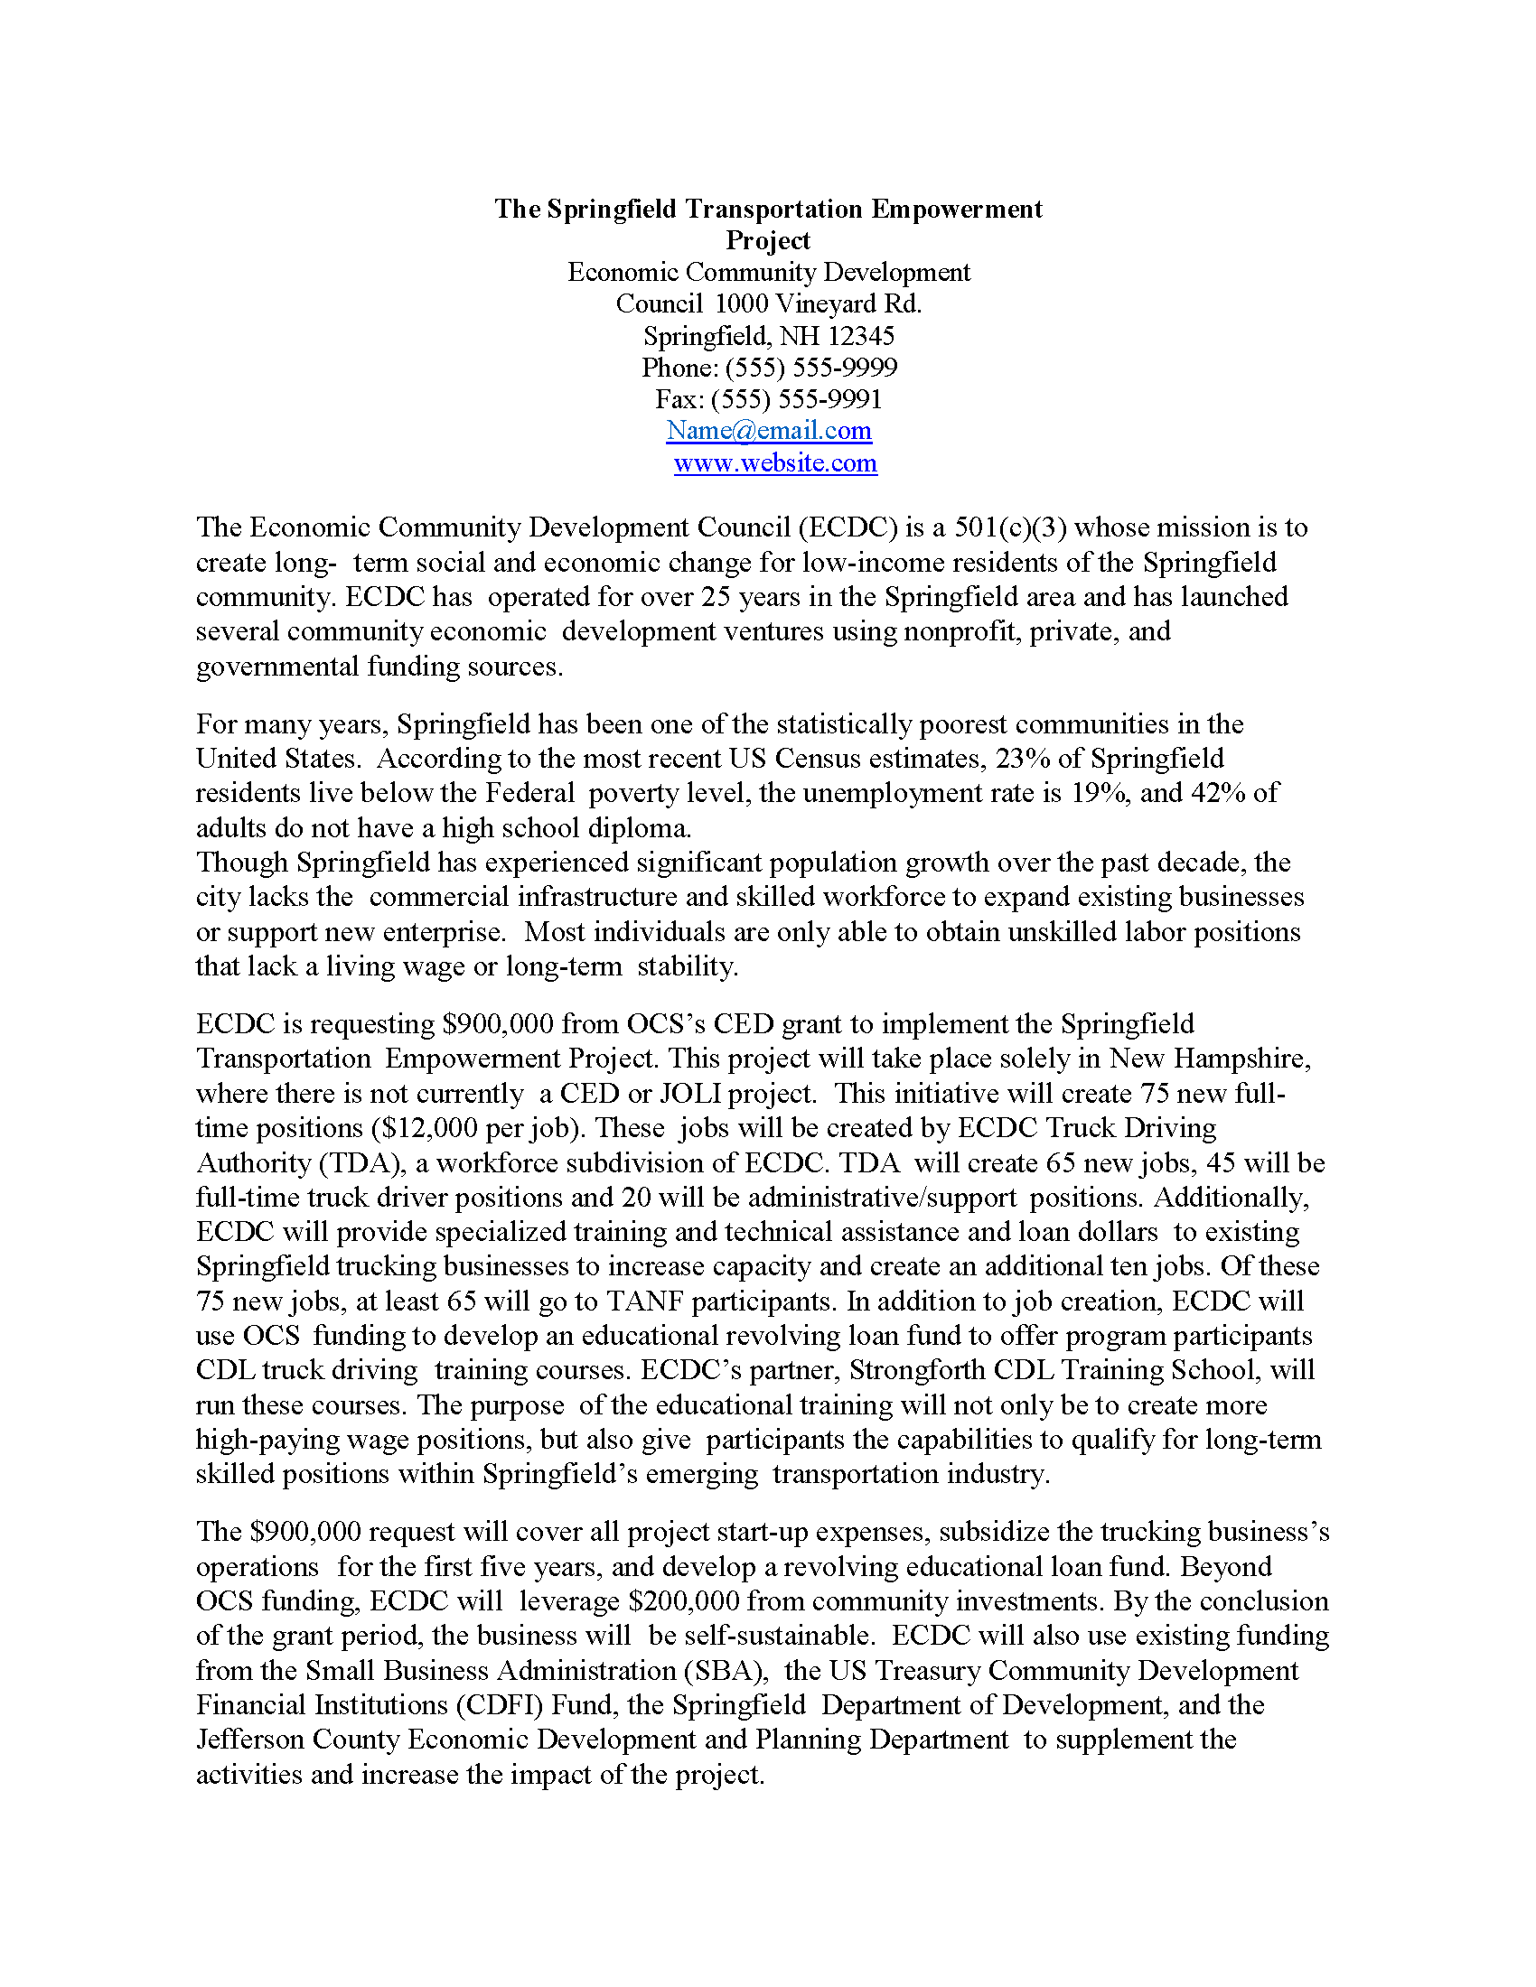
Organization description
Demographic information of target population
Existing community barriers
How project will overcome community barriers
Feasibility of project
Source: https://www.acf.hhs.gov

Slide 53
Needs or Problem Statement
Analyze the situation using the best data you have available and cite where possible
Provides an analysis of the problem and how you plan on addressing it
Outlines strengths and weaknesses of current situation
Establish the community need, not your organization’s need. The lack of a program is not the problem.
Notes:
Show both the strengths and weaknesses of the current situation.

Slide 54
Needs Statement Examples:
Example #1: Initial statement – not approved for funding:
“Many of the children we will be serving come from families with a lower income. The daycares we are partnering with serve mainly the lower income kids. By us partnering with them the kids will have access to books they wouldn’t usually be able to be in contact with.”
Source: http://healthandwelfare.idaho.gov/

Slide 55
Needs Statement Examples:
Attempt #2 : Was approved for funding
In the 2010-2011 school year 90% of our Kindergarten students qualified for free/reduced lunch. At the beginning of the school year 68% did not meet the benchmark for the IRI (Idaho Reading Indicator). 19% of our Preschool and Kindergarten students have developmental disabilities/delays. 23% of the Kindergarten students are English Language Learners. These children must have access to books in order to be better prepared when they enter kindergarten, and we can provide them through this program if our application is accepted.
Source: http://healthandwelfare.idaho.gov/
Notes:
includes data and statistics in the response

Slide 56
Writing the Project Description
SMART objectives:
  Specific
  Measurable
  Attainable
  Realistic
  Timebound
Notes:
Specific- must point out who will benefit and specify what will be measured
Measurable - Can it be tracked easily with valid measurement tools, such as surveys, pre- and post-needs assessments, and more? Use measure-indicating words such as increase, decrease, reduce, improve, lower, or raise. Also include a percentage benchmark.
Attainable - Can your organization really pull off the objective?
Realistic - Can the measurement actually be attained for the target population in the given time frame?
Timbound - Can your organization accomplish all the required tasks to achieve the objective in the given time frame? Make sure your objective contains a timebound phrase, such as by the end of Year 1, or the first semester, the second quarter, the grant-funding period,

Slide 57
Writing the Project Description
Should contain a clear description of the activities you plan to conduct to move toward the goals and objectives you have stated.
Go through the same steps your organization will take to develop and carry out the program or project.
The reader should easily see how you are going to accomplish your goal.
  Use words, timelines, and charts, help them imagine what the program will look like.
Paint a picture of how the program will look through the eyes of a your target population.
Don’t make the funder guess how you will use the money to reach the desired result for your population.

Slide 58
The Evaluation
  Internal or External?
  Quantitative data
  Qualitative data
  How will the evaluation be performed?
  What data will be collected? When?
  How will it be analyzed and reported
Notes:
Quantitative data
Associated with numbers
Implemented when data is numerical
Collected data can be statistically analyzed
Examples: Height, Weight, Time, Price, Temperature, etc.
Qualitative data
Associated with details
Implemented when data can be segregated into well-defined groups
Collected data can just be observed and not evaluated
Examples: Scents, Appearance, Beauty, Colors, Flavors, etc.

Slide 59
The Evaluation
  Check the guidance
  Two common types of measures:
    Process measures
    Outcome measures
Notes:
Process measures
The specific steps in a process that to a particular outcome metric.
Outcome measures
a systematic way to assess the extent to which a program has achieved its intended results.

Slide 60
The Evaluation
  Formative Evaluation
  Summative Evaluation
  It’s important that the evaluation contributes to sustainability
Notes:
Formative Evaluation
a method for judging the worth of a program while the program activities are in progress.
Summative Evaluation
summarizes the impact of what you’ve done, or the results of your project.

Slide 61
Example Evaluation Section of Proposal
Measuring the Success of the Ridge, Kids and Stewards Program
Currently, program facilitators administer both a pretest and a posttest to youth participants in order to measure what information is learned by the students during the six-week program. At the conclusion of each session, we also ask participating teachers to complete a detailed evaluation questionnaire so we can continue to find ways to improve an already excellent program.
The Ridge, Kids and Stewards (RDK) program is also regularly evaluated by an outside panel of professional evaluators. Because it is our goal to teach young people to become stewards of the environment, the RKS program coordinator and others are working to develop a more sophisticated, yet practical, evaluation process in order to measure the long-term impact of the program on youth who participate.
https://www.thebalancesmb.com/grant-proposal-evaluation-section-2501961

Slide 62
Sustainability
Building awareness and support
Originates from accomplishment of goals and objectives
Benefit of the program to the community
Importance of evaluation to sustainability
Building relationships
Community exposure
Communication plan
Local and non-local funding sources – Private and Public: Fee-for Service
Notes:
Building awareness and support – more than just funding
Benefit of the program to the community – clearly show why important
Importance of evaluation to sustainability – data and evidence of success
Building relationships with the community, key stakeholders, partners, and others
Community exposure – civic group meetings, newspaper articles, marketing
Communication plan and function has sustainability focus

Slide 63
Budget
A well-defined budget defines all costs related to project implementation including the funding source contribution and other contributors (in-kind support, matching funds).

Slide 64
Matching Funds
Participation by the grantee in the cost of a program on a dollar-for-dollar basis or other predetermined ratio or basis, such as 10% or 20%

Slide 65
Direct Costs
      Salaries and wages of personnel who will work on the project
      Fringe benefits associated with these personnel
          Taxes (FICA, Medicare, etc.)
          Benefits (health insurance, disability insurance, retirement contributions, pension plan, etc.)
      Equipment needed to perform the tasks (purchased or leased equipment)
      Supplies
      Travel (purpose of travel should be outlined)
      Consultant services
      Subcontracts
Notes:
Direct costs refer to materials, labor and expenses related to the production of a product. Other costs, such as depreciation or administrative expenses, are more difficult to assign to a specific product, and therefore are considered indirect costs.

Slide 66
Indirect Costs
Budget item that represents costs incurred by the grantee in carrying out a program that are not readily identified a direct expenditure.
      Space (rent)
      Utilities
      % of Management Time (Executive Director oversight, accounting assistance, human resources)
Notes:
Some grants don’t allow indirect costs to be included on the grant funds.

Slide 67
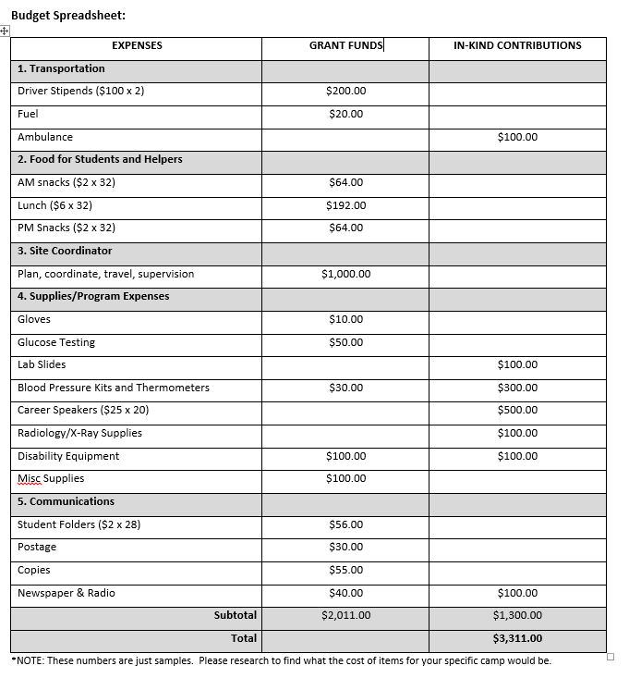
Budget
Table
SAMPLE ONLY
Example in Tab 14
$2,500 maximum allowed on grant;
$2,011 amount being requested from the grant
Notes:
Maximum grant award amount on this grant is $2,500; $2,011 is being requested from the grant funds.

Slide 68
Budget Narrative
How many organizations are contributing to the budget?
What percent of funds are being solicited from the funding source?
What year will peak funding occur and why?
Are subcontracts involved?
Annual salary increases
Notes:
Use Scrubs Camp RFP narrative example

Slide 69
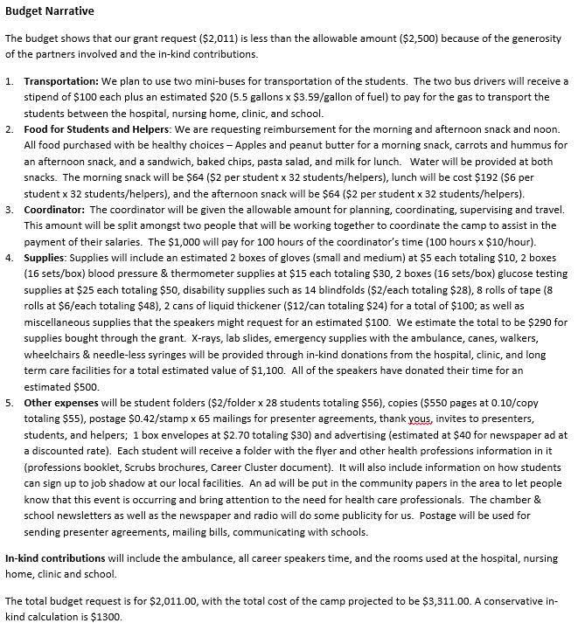
Budget
Narrative
SAMPLE ONLY

Slide 70
Other possible sections
Credibility – why should the funder invest in you and your project? They want to know that you will spend their money wisely. If this section is requested, demonstrate your ability through concrete examples:
  The CFO will be managing the grant funds and has 12 years of grant management experience, 8 years with XX hospital.
  XX hospital has received and managed several grants over the years, including the Flex grant administered through the Center for Rural Health for 13 years and the BCBSND Rural grant for 4 years.

Slide 71
Follow-up
Check notification dates
Write thank-you note, funded or not
If successfully funded, read Notice of Grant Award (NGA) carefully
If proposal is not funded, ask for feedback from funding agency
Rewrite/Resubmit
Explore other funding sources

Slide 72
Reasons for not receiving a grant:
Inadequate planning or carelessly prepared proposal - 39%
Competency of applicant not shown - 38%
Nature of project - 18%
Misc. - 5%
Source: U.S. Public Health Service

Slide 73
Final Take-Away
Start a Credibility File
Start a Boiler Plate File
Make a list of 3-5 projects you would like to do
Remember CRH and RHIhub as a resource
Read guidance carefully and develop an outline/checklist
If successfully funded - Be accountable/timely to funding agency - Communicate
If not successful - Try again!

