Slide 1
Improving Emergency Department Transfer Communication in Critical Access Hospitals
June 4th, 2026
Presenters: Anna Walter, Stephanie Fugleberg, Kristen Jung, Megan Sylling, and Montana Halberg
Notes:
Today we will discuss the work completed to improve Emergency Department Transfer Communication, or EDTC, in Critical Access Hospitals across North Dakota. We’ll review why EDTC is important, how the cohort was structured, the quality improvement methods used, and the outcomes and lessons learned from the project.

Slide 2
Objectives
Describe the importance of Emergency Department Transfer Communication (EDTC)
Describe the EDTC cohort model and improvement strategies used by participating CAHs
Describe measurable outcomes and lessons learned from the first year of implementation
Notes:
Our objectives today are to describe why EDTC is important, explain the structure of the EDTC cohort project, review the quality improvement tools and strategies used by participating hospitals, and share the impact and lessons learned throughout the project.

Slide 3
Why is EDTC important?
Communication is critical during emergency department (ED) patient transfers
Transfers require accurate and timely information
Poor communication can impact patient safety and outcomes
Critical Access Hospitals (CAHs) frequently transfer patients to a higher level of care
Notes:
When patients are transferred from one facility to another, especially in emergency situations, communication is essential. Receiving facilities need accurate and timely information to continue care safely and efficiently. Gaps in communication can lead to delays, duplication of services, or even patient harm. EDTC measures help organizations evaluate and improve those transitions.
Additionally, patients from a nursing home that are being transferred back or returned to the nursing home are also included in the EDTC data.

Slide 4
North Dakota Flex Program
Located at the UND Center for Rural Health
Grant funded by Health Resources Services Administration (HRSA)
Supports Critical Access Hospitals and their owned/operated Rural Health Clinics in North Dakota
Oversees CAH Quality Network and ND RHC Network
One focus area of the grant is to provide quality improvement
Notes:
Before we get into the details of the EDTC measure, I want to explain where this measure comes from and who oversees it.
The North Dakota Flex Program, located within the UND Center for Rural Health, supports Critical Access Hospitals through quality improvement initiatives, education, and technical assistance. The program is funded through a grant by HRSA and focuses on strengthening rural healthcare systems and improving patient outcomes.
Within the CAH Quality Network we host Quality Meetings where staff from CAHs who complete the quality work and reporting are able to get together to network and ask each other questions on the various MBQIP measures or quality improvement in general.
The Flex grant have a few domains where our work and activities must support- Quality Improvement, Financial & Operational, Rural EMS, and CAH Designation.

Slide 5
Medicare Beneficiary Quality Improvement Program (MBQIP)
National Quality Improvement Initiative
Focuses on improving patient care in Critical Access Hospitals
Five Domains: Global Measures, Patient Safety, Care Coordination, Patient Experience, and Emergency Department
Notes:
MBQIP is a national initiative designed to help Critical Access Hospitals improve the quality of care they provide. The CAHs in our state collect and submit data on several quality measures, including EDTC. These measures help identify opportunities for improvement and track progress over time
These MBQIP measures are unique to CAHs. The MBQIP measures are decided by the Federal Office of Rural Health Policy based on alignment with CMS and CD national quality measure standards. They do change at times.
Under these 5 domains are 9 MBQIP measures.
An area of quality improvement the Flex program wanted to focus on this grant cycle was on EDTC.

Slide 6
EDTC Elements
Improve the transitions of care from the CAH to other healthcare settings to improve patient outcomes.
Eight Elements- Goal to meet all 8
  Home Medications
  Allergies and/or Reactions
  Medication Administered in ED
  ED Provider Note
  Mental Status/Orientation Assessment
  Reason for Transfer and/or Plan of Care
  Tests and/or Procedures Performed
  Tests and/or Procedure Results
Notes:
The EDTC measure focuses on ensuring important patient information is communicated during transfers. This includes documentation such as reason for transfer, medication information, provider communication, and patient records. Strong transitions of care improve patient outcomes, support continuity between facilities and reduces errors

Slide 7
ND EDTC Cohort Project
Project Timeframe: November 2024- August 2025
Project Purpose: Improve EDTC scores for CAHs not performing at 100% in all 8 elements
Short Term Goal: All cohort CAHs reach 100% in one EDTC element not currently meeting by Qtr 2, 2025.
Long Term Goal: Reach 100% in all eight EDTC elements (Aug 2029)
Notes:
This cohort project ran from November 2024 through August 2025.
The goal was to support Critical Access Hospitals that were not consistently meeting EDTC performance benchmarks. Through collaboration, coaching, and quality improvement activities, hospitals worked to strengthen their transfer communication processes.
The EDTC data does lag slightly, so Quarter 2 of 2025 for the months of April thru June 2025, was the baseline data used.

Slide 8
EDTC Cohort Selection Process
Used data from EDTC quarterly submissions provided by the Flex Monitoring Team
Identify which CAHs not meeting 100% in all elements
Invitation to CAHs to participate in cohort
Notes:
The selection process used quarterly EDTC data provided through the Flex Monitoring Team. The baseline data used was from Quarter 2 of 2024 which was April thru June 2024.
Hospitals that were not consistently achieving 100% compliance in EDTC measures or hospitals with one very low element were identified as possible participants. Once those CAHs were identified, I reached out to discuss the EDTC cohort we were going to be starting, provided their data to show why we would like them to participate and asked if they would be willing to take part. The goal was to provide focused improvement support where it was most needed.

Slide 9
EDTC Cohort Participants
West River Health Services
CHI St. Alexius Health Dickinson
Sakakawea Medical Center
CHI St. Alexius Health Devils Lake (now Altru Hospital- Devils Lake)
Sanford Health Mayville
Notes:
This slide shows the 5 CAHs that participated in the cohort. We are very appreciative of these participating hospitals and their commitment to quality improvement. Their willingness to share challenges, strategies, and successes created a strong collaborative learning environment throughout the project.

Slide 10
Cohort Structure
Cohort meetings were held quarterly
  Identified gaps
  Quality methods were reviewed including PDSAs and Process mapping
  Peer sharing conducted
1:1 meetings were held
  Individual PDSAs created and implemented
Notes:
The cohort met quarterly to review progress, discuss barriers, and share strategies. Hospitals were introduced to quality improvement tools such as PDSA cycles and process mapping. The structure encouraged peer-to-peer learning and ongoing accountability.
Additionally, I held individual one on one meetings with each CAH to create a PDSA specific to their facility.

Slide 11
Cohort Kickoff
Cohort Kickoff Meeting- November 2024
  Review of EDTC measure
  Fact Finding Questions
  PDSA cycle- Plan and Do
    Each facility implemented a PDSA cycle
Notes:
The kick-off meeting of the cohort focused on building a shared understanding of the EDTC measure by reviewing the measure and it’s 8 elements.
We then asked each facility a series of fact-finding questions, which I’ll share on the next slide. These questions helped the hospitals learn how others are approaching the process, recognize shared challenges and barriers where breakdowns may be occurring in their current processes.
The remainder of the meeting consisted of reviewing the quality improvement method of a PDSA cycle, which is PLAN, DO, STUDY, and ACT. And asking each facility to think about one area of their EDTC process or a specific element they would like to focus on improving first. I would then follow up a few weeks later individually to start a PDSA for that facility focusing on the Plan and Do phases first.

Slide 12
Fact Finding Questions
What challenges or barriers are you experiencing that is prohibiting you of achieving 100% in all EDTC elements?
Do you have a process in place to ensure all necessary information is collected before transfer?
What is your main form of transferring communication? EMR, Fax, Sent with Patient
What processes do you have currently in place for transferring patient information to receiving facilities?
Do you have any measures in place to monitor and evaluate EDTC performance?
Notes:
These are the fact finding questions each facility discussed during the first cohort call. These questions helped hospitals examine their current workflows and identify barriers preventing consistent EDTC compliance. These conversations encouraged participant engagement.

Slide 13
Barriers Identified
Common challenges included:
  Documentation gaps and inconsistency
  Reliance on manual processes
  Communication
  Lack of standardized workflow
  Staff training and education
  Monitoring
  Staff time constraints
  EMR limitations
Notes:
Although each hospital had unique workflows, many of the barriers were similar. Common challenges included inconsistent documentation practices, reliance on manual workflows, communication gaps, and difficulties related to staff turnover or temporary staffing

Slide 14
PDSA
PLAN
What specific element of EDTC would you like to focus on improving on?
Who are the stakeholders that will need to be involved?
What data/information will need to be collected to measure success?
DO
How will you implement change?
Who is responsible for executing the plan?
What training or support with staff need?
How will the changes be communicated to everyone involved?
Notes:
The PDSA cycle provided a structured approach to improvement. This framework supports continuous learning and improvement.
After the first cohort meeting, I set up individual meetings with each CAH to start the PDSA process. We began with having them focus on the Plan and Do portion of the PDSA process. Each Hospital identified a specific area to improve and created a plan to implement it. This slide shows the questions I sent the CAHs in preparation of us meeting so they could have a plan in place.
After I discuss the cohort structure and process, these ladies will share with you their PDSAs they put in place at their facilities.

Slide 15
Second Cohort Meeting
February 2025
  Peer-to-Peer sharing
    CHI St. Alexius Health Carrington Medical Center
    Heart of America Medical Center
  Individual Facility PDSA Updates
    Study and Act phases
  Process Mapping Education and Homework
    Individual Facility to Process map their EDTC process
Notes:
The second cohort meeting focused heavily on peer learning where we started with peer-to-peer sharing. We had two facilities, CHI Carrington and Heart of America Medical Center, who have been consistently reaching 100% in all 8 EDTC elements share their EDTC process and experiences within their facility and how they ensure documentation occurs for each transfer. They also provided their transfer documentation sheet for the participants. These conversations allowed hospitals to learn practical approaches from one another and adapt ideas to their own workflows.
We then continued with each CAH sharing what PDSA they put in place and how they plan to implement it. After the sharing, the next step was was to continue with the PDSA process to work on the Study and Act phases of the PDSA cycle, dependent on where they were at in the process.
Lastly I provided education on another quality improvement process called Process Mapping. The homework for the CAHs were to process map their current EDTC process (from the time the patient arrives to their ED, to when they are transferred) and bring that back to share at the next cohort meeting.

Slide 16
PDSA
STUDY- collected data from doing the plan
What data was collected and how was it analyzed?
Did the implementation go as planned? What challenges were encountered?
What did we learn from the data about the change?
What unexpected results were observed?
ACT- on the results after studying data collected from doing the plan
What changes should be made based on our findings?
How can we sustain the successful changes?
What additional tests or cycles might be necessary?
How will we share the results with the team and stakeholders?
What will our next steps moving forward be?
Notes:
These were the questions to help the CAHs in the Study and Act phases of the PDSA cycle. The hospitals started to evaluate whether their changes were improving EDTC compliance. They reviewed collected data, discussed successes and challenges, and determined what adjustments were needed moving forward.

Slide 17
Process Mapping
What is Process Mapping in healthcare?
  A visual representation and analysis of the sequential steps and interactions involved in delivering healthcare services to patients.
  Helpful for a shared understanding of current process and ideal future state
  Identify: inefficiencies, bottlenecks, & areas of improvement
  Leveraging Process Mapping
Resources:
  Process Mapping Template
  EDTC Specs Manual Processing Mapping Document
  Develop Individual Process:
    Speak with staff or watch the process in ED
    Utilize visuals- whiteboard, post it notes, etc
    Discuss current process and identify any areas that differ or for improvement/change.
    Create a new or ideal process for the future.
    Train staff if needed
Notes:
Process mapping is a quality improvement too that helps organizations visualize every step involved in patient transfers. By mapping the workflow, hospitals could identify inefficiencies, communication breakdowns, or missing documentation steps that contributed to EDTC gaps.
This is a slide used during the 2nd cohort meeting to explain what Process Mapping is and some tools and resources they could use to support them in Process Mapping their EDTC process.
The resources provided was a link to a short video created by Telligen, _________. Additionally, I provided a sample template that I will show on the next slide. I also worked with our Flex MBQIP TA group called RQITA to utilize the EDTC Speculation Manual to create a document they could use to track the process for each element.

Slide 18
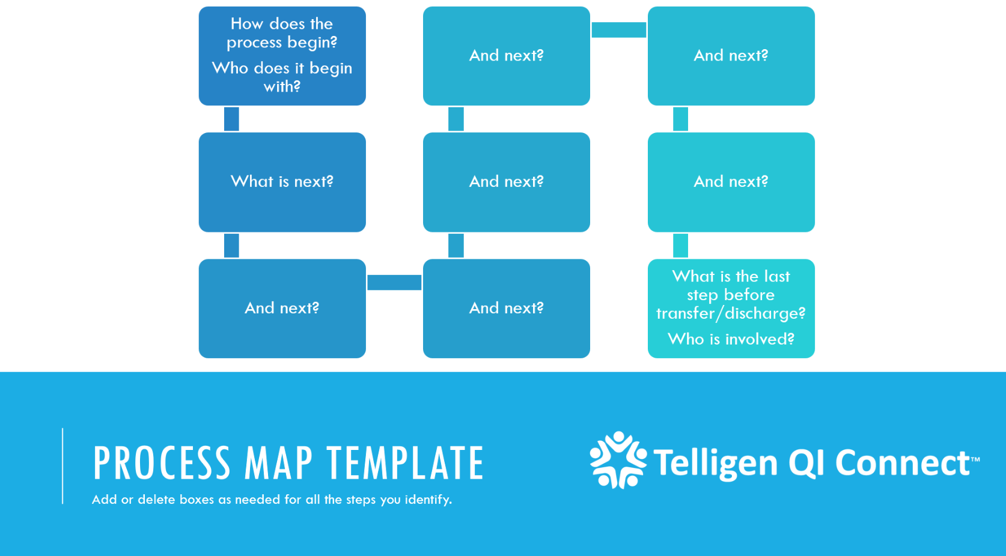
Process Map Template
Notes:
This template helped hospitals organize and document their transfer processes step by step. It provided a visual framework to identify gaps and redesign workflows to improve consistency and communication.

Slide 19
Third Cohort Meeting
May 2025
  Sharing of current EDTC process as identified from process mapping and discuss any changes/discrepancies identified
  PDSA sharing
    Began work on Study and Act parts of PDSA cycle
  Homework
    Complete Process Mapping project to identify what the new EDTC process will be
Notes:
During the third cohort meeting, participating hospitals shared their process mapping they completed. They discussed their current workflows and discussed any changes or discrepancies they identified. Teams reviewed what was working well, identified areas that still needed improvement.
Additionally, they all gave an update on their PDSAs. Some had completed the full PDSA at this point and others were still working on it.
They final homework for the cohort was to create a new process map for their EDTC element collection at your facility from the identified areas of inconsistency and determine how staff will be trained on the new process to ensure all 8 EDTC elements are collected.

Slide 20
Final Cohort Meeting
August 2025
  Sharing of new EDTC process as identified from process mapping
  Final update on Individual Facility PDSAs
  Follow up on results
Notes:
The final cohort meeting focused on each CAH sharing their updated EDTC process workflows, sharing their final project outcomes.
I also provided an update to the CAH’s on their data on how it changed throughout the process. I should note that after each EDTC reported deadline, I did follow up with the CAHs on their data and how they were doing. Positives and negatives.
Lastly, we discussed the results from the work they put in the past year. Before I share the results of the cohort, we have three of the facilities here with us today that participated in the EDTC Cohort that will share their PDSA’s that they implemented and changes they saw. I would like to introduce Stephanie Fugelberg from Sanford Mayville to discuss their PDSA cycle.

Slide 21
PDSA Cycle for Sanford Mayville
Act
QAPI review quarterly
Plan
SBAR
Do
Study
Process Mapping
ND Flex Partnership
Staff Education
Standardization
Signage
Run Graphing
Chart Review/Audit
RedCAP tracking
Individual Staff Feedback
Adaptation and Adoption
Notes:
Objective: to improve EDTC performance at Sanford Mayville Medical Center
Implementation Strategy: SBAR communication, PDSA cycles, process mapping was used to identify inefficiencies and determine standardization. Project 2020 RedCAP was used for data collection and analysis along with collaboration with ND Flex Team EDTC Cohort.
Interventions: Staff Education took place which focused on the background of the EDTC measure, inclusion and exclusion criteria as well and documentation standards. Use of ED focused transfer flowsheet within EMR which emphasized required documentation for transfers and standardized documentation. Ongoing chart reviews were conducted to identify gaps and reinforce learning.
Monitoring and Feedback: EDTC performance is reviewed quarterly with nursing staff, managers and leadership. Monthly quality checks were complete by the improvement advisor and fallouts are communicated to ED nurse manger for follow-up. Individual feedback is provided to the primary nurse involved in transfer to support continuous improvement including staff completion of chart audit.

Slide 22
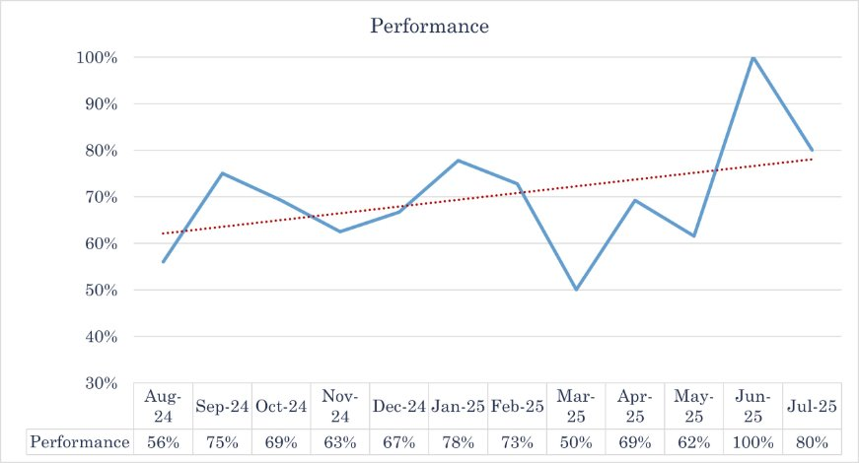
Sanford Mayville
Next Steps
Initiate expanded staff education through onboarding inclusion
Increase frequency of chart reviews and staff feedback to weekly.
Refine documentation requirement and prompts within the EMR
Notes:
EDTC performance has fluctuated but following the work done with the ND flex program and EDTC cohort we achieved 100% for June 2025 indicating full compliance across all eight EDTC domain. July 2025 maintain high performance at 80% suggesting sustain improvement.
Next steps included
-expanding staff education through onboarding inclusion. Through this project we identified that staff were unaware of the background of the measure and the importance of patient outcomes.
-Increased frequency of chart reviews and staff feedback to weekly. Real time (or as close to) feedback as been more effective in changing staff performance
-Work on efforts to refine documentation and prompts within the EMR.
A key deficiency in transfer communication was noted to be discharging ED patients back to their referring skilled nursing facility.
Through the collaboration with the ND FLEX program and EDTC cohort we see the date supports the conclusion that structured quality improvement methods can improved performance in rural hospitals. The rise in performance post-intervention highlights the impact of targeted process changes and staff engagement.

Slide 23
PDSA Cycle for
West River Health Services
Topic:
  Which areas are close to meeting 100%
Improvement Area:
  Increase compliance with EDTC 2 (Allergies/Reactions and EDTC 5 (Mental Status/Orientation Assessment) to 100% through standardized workflows, targeted education, and ongoing audit/feedback.
Implemented actions:
  Delivered education to nursing staff on EDTC requirements and performance expectations
  Engaged frontline staff to identify workflow gaps and improvement opportunities.
  Implemented a monthly audit process for transferred patients to monitor compliance
  Provided individualized feedback to staff, highlighting missed elements and reinforcing documentation standards

Slide 24
West River Health Services
Barriers:
  Variability in documentation practices across staff
  High utilization of traveler/temporary staff impacting consistency
  Knowledge gaps related to EDTC requirements and expectations
  Workflow inefficiencies during high-volume or high-acuity periods
Lessons Learned:
  Ongoing, targeted education is necessary but not sufficient alone
  Real-time feedback and accountability significantly improves compliance
  Standardizing workflows reduces variability more effectively than education along
  Leadership visibility and reinforcement drive sustained improvement.
Next steps:
  Implement focused re-education, add prompts into the workflow, and initiate routine audits with provider-specific feedback.

Slide 25
PDSA Cycle for
Altru Hospital- Devils Lake
Purpose: To identify trends affecting EDTC compliance and implement education and process improvements to improve performance.
Key Stakeholders: Becca Thomas, RN Case Coordinator and Montana Halberg, ER Supervisor, along with ER staff nurses
Plan: Review of data from Previous quarters to identify trends, recognition from leadership of educational enhancements, collaboration with former RN Case Coordinator for historical trends
Opportunities: Increase staff education for travel partners and ER staff to remain within compliance of EDTC regulations and identify and standardize clear documentation within the medical record

Slide 26
Altru Hospital- Devils Lake
WIN: Strategic planning in conjunction with historical trends helped achieve a 100% compliance on all additional EDTC auditing!!
Follow-up Implementation: Focus placed with ongoing nurse education for new hires and travel partners, continued EDTC education for all staff, preparation for the implementation of a new EMR with Altru (Epic from Meditech) and if this changes the process of EDTC charting and compliance.

Slide 27
PDSA Cycle for
Sakakawea Medical Center
Topic / Area of Improvement:
• Improving ED-to–Skilled Nursing Home transfer communication (EDTC)
Why We Chose This Topic (Root Cause):
• Skilled nursing home residents were often discharged as “home” instead of “transfer”
• This workflow failed to trigger EDTC-required documentation
• Transition-of-care information was at risk of being missed or incomplete
Barriers Encountered:
• Long-standing habit of selecting “discharge home”
• EMR workflow limitations early in the project
• Limited EMR prompts early in the process
What We Implemented / Tested:
• Staff education on EDTC elements and documentation expectations
• Updated EMR Dispo tab to specify discharge destination
• Added EDTC elements directly into the EMR
Notes:
We focused our PDSA on ED-to–skilled nursing home communication after recognizing that residents returning to facilities were often discharged as “home,” which did not trigger EDTC documentation. While verbal report was usually provided, supporting documentation was inconsistent. Education alone helped somewhat, but we recognized that building the process into the EMR was necessary to create reliable, sustainable change.
Not all EDTC elements were on transfer summary, updated to all now
Education monthly, meeting with staff individually, pulls transfer each day to review

Slide 28
Sakakawea Medical Center
Key EMR Change:
• Dispo tab now requires selection of where a patient is discharged to
• Options include Private Residence, Skilled Nursing Home, Assisted Living, etc.
Safety Improvement:
• Selecting Skilled Nursing Home now fires a Best Practice Advisory (BPA)
• BPA prompts completion of required EDTC documentation—same as a transfer
Outcome / What Improved:
• EDTC elements are now embedded directly in the EMR
• Improved consistency and reliability of transfer documentation
• Reduced reliance on memory and manual reminders
Ongoing Work:
• Continued staff education and reinforcement
• Monitoring EDTC completion and follow-up when missed
• Ongoing collaboration with EMR partners for refinement
Notes:
The most meaningful improvement came when we were able to align workflow with documentation expectations. The Dispo tab now requires staff to choose the discharge destination, and when Skilled Nursing Home is selected, a BPA fires just like it does for transfers. This ensures EDTC documentation is completed consistently. By embedding EDTC elements directly into the EMR, we reduced reliance on workarounds and made the safer process the easier process.
Reached out to Altru leads that work on EMR workflows. From initial talks to when it was implemented- about 1.5 year.
When pt ready to go somewhere- Dispo tab to pick where they are going – Before Home, Admit, Transfer, Other available - Now- when pick Home- hard top to now picked where (Home, Skilled Nursing Home, Assisted Living, Law Enforcement, OR & Other) When Skilled Nursing Home- it triggers a Best Practice Advisory (BPA) pops up that they need to complete the transfer summary- this form has all the EDTC elements. Will constantly be popping and alerting until it satisfies the advisory.
Been in place since February 2026

Slide 29
Improvement Process Recap
Participating Hospitals:
  Reviewed ED transfer process
  Identified gaps
  Implemented improvement strategies
  Measures results
Quality Improvement Methods used:
  Plan Do Study Act (PDSA) cycles
  Process Mapping
  Peer to Peer Learning
Notes:
As previously discussed to recap, throughout the project the hospitals reviewed their transfer workflows, identified gaps, implemented targeted strategies, and continuously monitored outcomes.
The process emphasized collaboration, data review, and continuous quality improvement.

Slide 30
Cohort Successes
Improved EDTC documentation
More consistent transfer communication
Increased staff awareness
Stronger transfer processes
Notes:
The cohort achieved several meaningful successes throughout the project.
Hospitals strengthened documentation practices, improved consistency in transfer communication, and increased staff awareness regarding EDTC requirements.
Many teams also reported stronger collaboration internally and a better understanding of how transfer communication directly impacts patient safety and continuity of care.

Slide 31
Cohort Impact
All five CAHs showed progress with improved EDTC scores.
  5 of 5 CAHs reached 100% in at least one EDTC element they weren’t currently
  2 of 5 CAHs reached 100% in all eight elements!
Participants reported satisfaction with all aspect of cohort, especially one-on-one support and the peer-to-peer sharing
Increased education for CAH staff on importance of EDTC
Notes:
All participating hospitals demonstrated measurable improvement during the cohort project.
The short term goal was to reach 100% in at least one EDTC element throughout the first year. Each hospital achieved 100% compliance in at least one EDTC element they weren’t currently meeting during the project period. These improvements demonstrate how focused quality improvement efforts, combined with collaboration and ongoing support, can lead to meaningful and sustainable outcomes.
By focusing on one element, we saw the Composite score of all 8 elements improve as well. From the baseline scores we used which were from Quarter 2 of 2024 and ended the cohort with Quarter 3 of 2025, the overall composite score for all the CAHs participating improved by an average of 13%

Slide 32
Impact on Patient Care
Improved EDTC helps:
  Improve patient safety
  Reduces errors
  Improve continuity of care
  Support receiving facilities
Notes:
Improving EDTC processes directly supports better patient care. When transfer communication is complete and timely, receiving facilities are better prepared to continue treatment without delays or missing information. Strong communication reduces the risk of errors, improves continuity of care, and helps ensure safer transitions for patients during emergency situations.
Better communication supports clinical decision-making and coordination

Slide 33
Lessons Learned
Each CAH has their own unique EDTC process, however they tend to have similar challenges and barriers
Staff engagement is critical
Small changes make big improvements
Standardization improve compliance
Ongoing monitoring is important
Ongoing EDTC education for staff is necessary
Notes:
One of the biggest lessons learned from this project was that many hospitals experienced similar challenges, even when workflows differed.
Staff engagement and leadership support were critical to successful implementation.
The project also demonstrated that small, targeted changes can lead to meaningful improvement when teams are willing to evaluate and adapt their processes.

Slide 34
Sustainability
Hospitals can sustain improvements by:
  Continuing monitoring EDTC data
  Training new staff on EDTC and its importance
  Updating procedures as needed
  Maintaining leadership support
Notes:
Sustaining improvement requires continued attention and reinforcement.
Continue monitoring EDTC data- if your score start to trend downward, that’s an indicator something isn’t working or following the process- PDSA?
Providing staff education, and incorporating EDTC expectations into onboarding and routine workflows.
Ongoing review and communication will help maintain consistency and support long-term success.”

Slide 35
Future Directions
EDTC data of participating CAHs will be monitored over the next four years.
Individual outreach and support will be provided as needed.
  Additional PDSA cycles as needed
Long Term Goal: Reach 100% in all eight EDTC elements (Aug 2029)
Notes:
Looking ahead, we will continue to monitor the EDTC data for the participating hospitals over the next four years.
We will continue outreach, education, and technical assistance to support hospitals as they maintain and build on their progress.
The success of this cohort also creates opportunities for future collaboration and additional quality improvement initiatives across the state.

Slide 36
Questions?
Anna Walter - Anna.Walter@und.edu
Stephanie Fugleberg - Stephanie.Fugleberg@sanfordhealth.org
Kristen Jung - Kristen.Jung@wrhs.com
Megan Sylling – Megan.Sylling@altru.org
Montana Halberg – Montana.Halberg@altru.org
Notes:
Here is all of our contact information. Thank you for your time and attention today. We appreciate the opportunity to share this project and would be happy to answer any questions or discuss ideas further.

