Slide 1
Preventing Youth Concussions in Rural North Dakota: Monitoring for Better Outcomes
Carly Endres, ms, cbist and
Andrea WATKINS, MS, CCC-SLP, CBIST
Notes:
Carly
Abstract: Youth in rural communities experience significant risk for concussion due to participation in high-impact sports, agricultural work, ATV use, and limited access to specialty care. Rural environments face additional barriers including fewer certified athletic trainers, longer travel distances to medical services, constrained school health resources, and persistent cultural norms encouraging youth to “push through” injury. This presentation explores how structured monitoring systems can function as both prevention and early intervention, improving safety and outcomes for rural North Dakota youth.
The session reviews current youth concussion prevalence with emphasis on North Dakota data, outlines evidence-based monitoring approaches, and examines how pre-injury baseline assessments, recognition-phase monitoring, and post-injury recovery tracking collectively reduce repeat injury and support safer return-to-learn and return-to-play decisions. Special attention is given to the role of coaches, educators, primary care providers, EMS, and families, as rural communities often rely on non-specialist gatekeepers. North Dakota concussion legislation, school policy expectations, and statewide supports—such as the North Dakota Brain Injury Network—are highlighted to demonstrate existing infrastructure that communities can leverage.
A practical implementation framework will be presented, including partnership development, monitoring tool selection, training strategies, telehealth integration, and evaluation metrics. Realistic rural challenges such as staffing limitations, stigma, and resource inequity are addressed alongside feasible solutions including local champion development, standardized protocols, and virtual care models.
Participants will leave with applicable strategies to strengthen concussion monitoring systems in their communities, enhance early recognition, reduce secondary injury risk, and promote healthier developmental, academic, and athletic outcomes for rural North Dakota youth.
Introduce selves-explain backgrounds and previous work experiences prior to NDBIN. Today’s overall goal is to educate you on why concussions matter in rural youth and how monitoring can prevent injury and improve recovery.

Slide 2
Learning Objectives
1️⃣ Describe the prevalence, risk factors, and rural-specific challenges associated with youth concussions in North Dakota.
2️⃣ Explain how structured monitoring before, during, and after injury improves early recognition, reduces repeat injury, and supports safer return-to-learn and return-to-play decisions.
3️⃣ Identify practical strategies and implementation steps rural schools, healthcare providers, and communities can use to strengthen concussion monitoring systems, including partnerships, policy alignment, and telehealth supports.
Notes:
Andrea

Slide 3

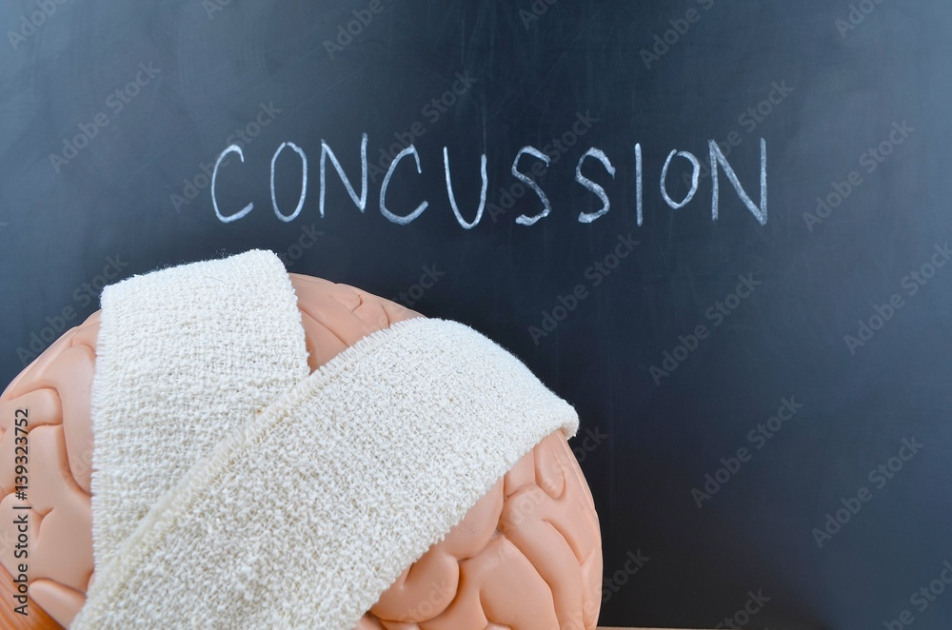
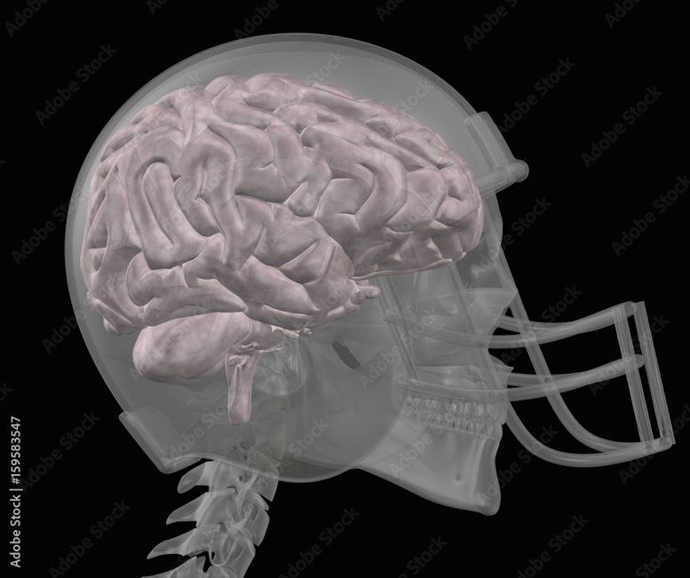
What Is Concussion?
Type of mild traumatic brain injury (mTBI)
Caused by a bump, blow, or jolt to the head or body
Changes how the brain normally works
Most occur without loss of consciousness
Most MRI/CTs are normal
Notes:
Carly
Brain injury with physical, cognitive, emotional, and sleep effects. Can result from sports, falls, motor vehicle crashes, and play.

Slide 4
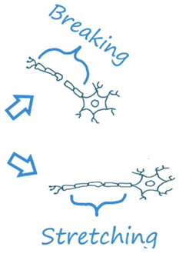
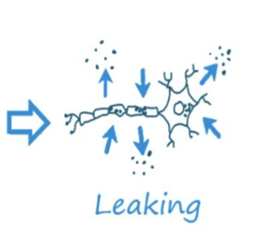
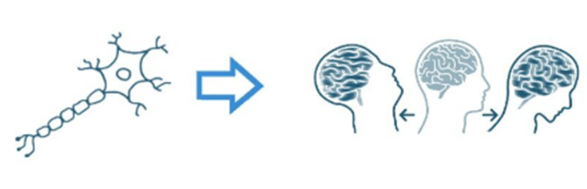
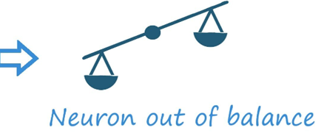
Concussion Continued
Damage is done on a neuro-molecular level - mostly a functional impairment, not structural
Notes:
Andrea
Connections between billions of neurons in your brain create a complicated web of pathways for your cells to communicate with each other. Your neurons and these connections allow you to do a wide range of tasks, such as throwing a ball, thinking, learning a new language, and processing emotions.

Slide 5
Youth Concussion: Scope & Epidemiology
Up to 3.8 million sports-related concussions annually among youth ages 10-19
Rural children show different patterns of injury (e.g., more motor vehicle crashes)
Rural settings often have higher mTBI incidence plus disparities in follow-up care and access to specialists
Notes:
Carly
To start, it’s important to understand the scope of the issue. Each year, we see up to 3.8 million sports-related concussions among youth ages 10 to 19. That’s a significant public health concern, especially in school and community sports. However, not all injuries look the same across populations. Rural children often experience different patterns of injury. For example, they may be more likely to sustain brain injuries from motor vehicle crashes or other non-sport mechanisms compared to their urban peers. We also see disparities in rural areas when it comes to mild traumatic brain injury, or mTBI. Rural settings tend to have higher incidence rates, but more importantly, there are gaps in what happens after the injury. These gaps include limited access to specialists, fewer local resources for evaluation and management, and challenges with consistent follow-up care. So while the injury itself is a concern, the bigger issue is often the difference in recovery support, which can impact outcomes for rural youth.

Slide 6
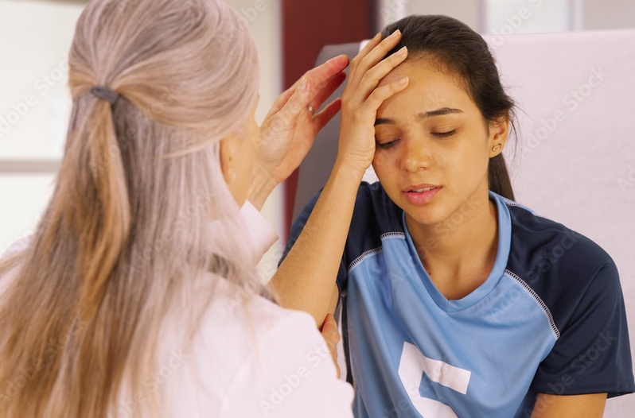
North Dakota Data
North Dakota Risk Behavior Survey (2023):
20.5% of middle school students reported ≥1 concussion in past year
16.6% of high school students reported ≥1 concussion in past year
Notes:
Andrea
At NDBIN we provide education, support, training, and resources for brain injury prevention and management statewide

Slide 7

Why Monitoring Matters
Monitoring is Prevention:
Detecting injury early prevents further harm (e.g., second impact syndrome, undiagnosed/misdiagnosed symptoms)
Awareness increases reporting and removal from play
Data supports safer return and informs policy
Notes:
Carly
Monitoring serves primary prevention (risk reduction) and secondary prevention (early detection & response).
This slide highlights an important idea: monitoring is prevention. The earlier we recognize a potential brain injury, the better we can protect the individual from more serious outcomes. Early detection is critical because it helps prevent further harm. For example, returning to activity too soon can increase the risk of second impact syndrome, which, while rare, can be life-threatening. It also reduces the chances of symptoms being overlooked or misdiagnosed. Another key piece is awareness. When athletes, coaches, parents, and educators understand the signs and symptoms of concussion, they are more likely to report concerns and remove someone from play right away. Finally, monitoring provides valuable data. Tracking symptoms and recovery over time helps guide safer return-to-learn and return-to-play decisions. On a larger scale, this data also helps inform policies and best practices, improving how we prevent and manage brain injuries across schools and communities.

Slide 8
Monitoring Before Injury
Baseline Testing:
Help compare post-injury results to personal norms, guiding safer decisions (e.g., ImPACT, SWAY)
Pre-Season Assessments:
Target all youth athletes to establish stable personal benchmarks
Notes:
Andrea
There are 3 big time points where monitoring should take place. And the first one is baseline testing before any injury. Completing baseline testing allows comparison to post-injury results to personal norms, which then guide safer decisions. Some common assessments used for baseline testing include the ImPACT and SWAY. A standard way to do baseline testing is to do pre-season testing, which should target all youth athletes.

Slide 9
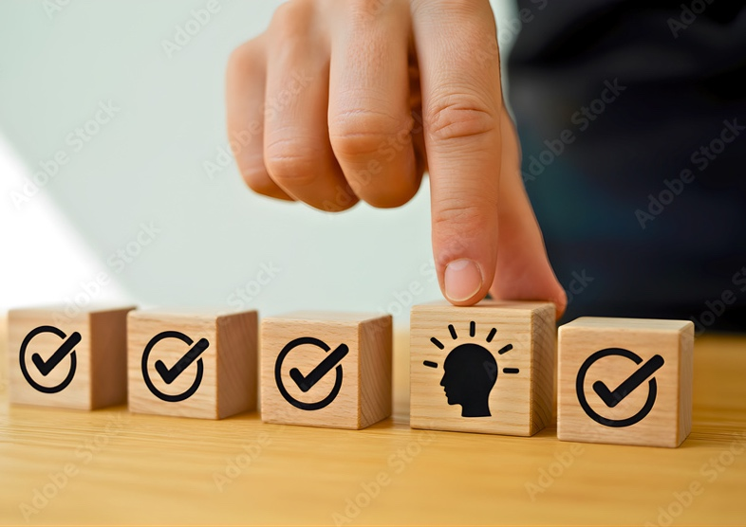
Monitoring During Play
Recognition Tools:
Symptom checklists for coaches, officials & parents
Sideline evaluation tools
Wearables (emerging, with caution)
Education + Awareness:
Coaches & officials must complete concussion training per ND policy before play
Notes:
Carly
During play, recognizing a potential concussion quickly is critical. We rely on a combination of tools and awareness—not just one method.
First, symptom checklists are a simple but effective way for coaches, officials, and even parents to identify possible signs of a concussion. These include things like headache, confusion, dizziness, or changes in behavior.
Second, there are sideline evaluation tools, such as standardized assessments used by trained personnel. These tools help guide decisions about whether an athlete should be removed from play, but they are not a substitute for a full medical evaluation.
You may also hear about wearable technology, like impact sensors in helmets. While these are emerging and can provide helpful data, they should be used with caution—they do not diagnose a concussion and should never replace observation and clinical judgment.
Equally important is education and awareness. In North Dakota, coaches and officials are required to complete concussion training before the season begins. This ensures that the people closest to the action understand what to look for and how to respond.
The key takeaway here is:
If there is any suspicion of a concussion, the athlete should be removed from play immediately and evaluated by a qualified professional. When in doubt, sit them out.

Slide 10
Monitoring After Injury
Structured Follow-Up:
Assess symptoms daily
Return to learn before return to play
Track cognitive function, sleep, mood, appetite
When recovery stalls, escalate care
Telehealth in Rural Care:
Virtual concussion clinics improve follow-up accessibility in rural settings.
Notes:
Andrea
After a brain injury, monitoring doesn’t stop once the athlete leaves the field—this is where recovery really begins.
First, it’s important to have structured follow-up. This means regularly checking in on symptoms—ideally daily in the early stages—to track changes over time. Symptoms can evolve, improve, or sometimes worsen, so consistent monitoring helps guide next steps.
We also want to emphasize return to learn before return to play. Cognitive recovery comes first. Students should gradually return to school and academic activities with appropriate supports before resuming sports or physical exertion.
In addition to symptoms, we need to track key areas of functioning, including:
Cognitive function—things like attention, memory, and processing speed
Sleep patterns—difficulty falling or staying asleep is common
Mood—watch for irritability, anxiety, or depression
Appetite—changes can signal ongoing issues
All of these give us a fuller picture of how the brain is recovering.
It’s also critical to recognize when recovery stalls. If symptoms are not improving as expected, or new concerns arise, that’s a signal to escalate care—which may include referral to specialists such as neurology, neuropsychology, or rehabilitation providers.
For those in rural areas, access can be a barrier. This is where telehealth becomes a valuable tool, allowing individuals to connect with specialists without needing to travel long distances.
The key takeaway is that recovery is not one-size-fits-all. Ongoing, structured monitoring helps ensure that each individual gets the support they need for a safe and successful recovery.

Slide 11
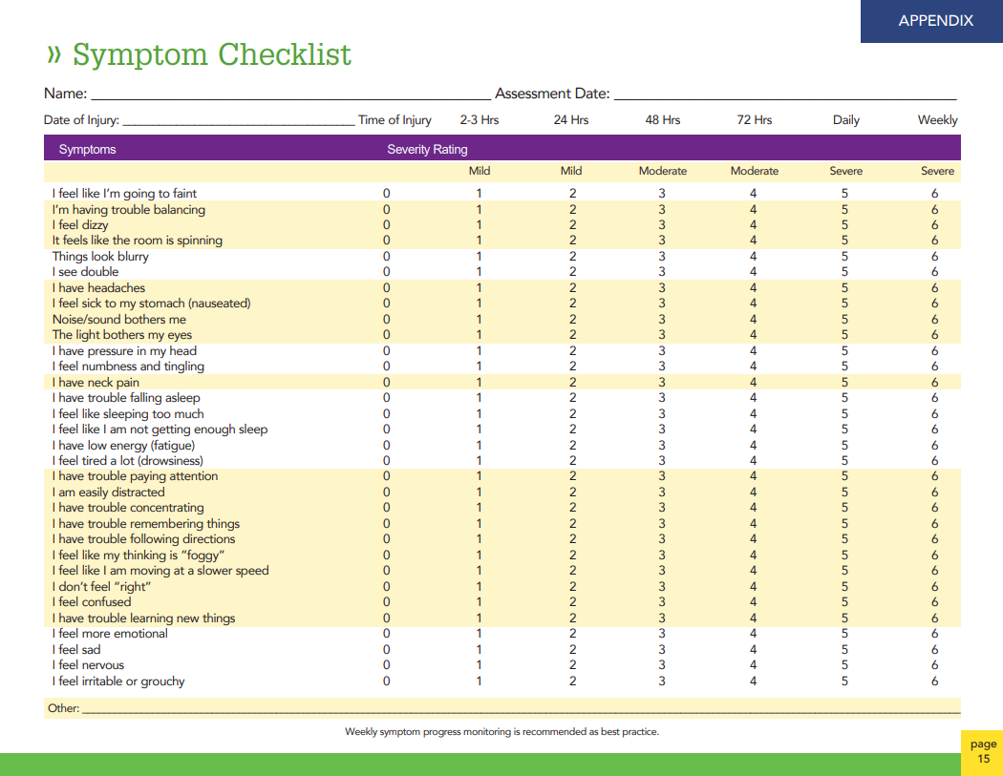
Daily/weekly symptom checklist
Copied from REAP: The Benefits of Good Concussion Management
Notes:
Carly
I utilize this page out of our REAP manual frequently and recommend this be completed every few hours at first, then 24, then 48 as you see across the top. There is also a parent and teacher version.

Slide 12
ND Concussion Law
All schools must have a concussion management program
Removal from play is mandatory for suspected concussions
Medical clearance required before return-to-play.
Training Requirements:
Coaches & officials must complete concussion training
Notes:
Andrea
In North Dakota, concussion management in school athletics is governed by state law, specifically requiring every school to have a concussion management program in place.
There are three key components to understand:
First, education.
Schools must provide information to students and parents about the signs, symptoms, and risks of concussion before participation. This ensures everyone starts the season informed and aware.
Second, removal from play.
If a student reports or shows any signs or symptoms of a concussion, they must be immediately removed from play. This responsibility applies not just to coaches, but also to officials and any designated personnel involved in the activity.
Third, medical evaluation and return to play.
Once removed, the student must be evaluated by a licensed healthcare provider trained in concussion management as soon as possible. They cannot return to practice or competition until they receive written medical clearance from that provider.
It’s also important to note:
The law prioritizes safety over competition—if there is any doubt, the athlete sits out.
Documentation of clearance must be maintained by the school.
Many programs also incorporate a return-to-learn process, recognizing that students may need academic supports before fully returning to sports.
This law reinforces a simple but critical message:
When in doubt, sit them out—and don’t return until medically cleared.

Slide 13
Best Practice Monitoring Strategies
School & Community Level:
Baseline tests (e.g., computerized or clinician-supervised)
Standard checklists for coaches & parents
Regular symptom monitoring post-injury
Education campaigns for athletes & families
Notes:
Carly
We will cover some ND specific information soon!

Slide 14
Supporting Monitoring Efforts
Community Partnerships:
Schools ↔ Clinics ↔ EMS ↔ ND Brain Injury Network
Shared reporting & data systems
Telehealth Networks:
Expand access to neuro-specialists and follow-up care, especially for remote communities
Notes:
Andrea
Effective brain injury prevention and management doesn’t happen in isolation—it depends on strong community partnerships. This includes coordination between schools, clinics, EMS, and organizations like us at the North Dakota Brain Injury Network. Each plays a role, from initial injury recognition to medical care and long-term support. When these partners are connected, communication improves. For example, a coach identifying a possible concussion can connect quickly with medical providers, and EMS can ensure appropriate care when needed.
Another key piece is shared reporting and data systems. When information is tracked and communicated across settings, it helps ensure continuity of care and reduces the risk of someone falling through the cracks.
Telehealth is also a critical part of this system, especially in rural areas. Telehealth networks help bridge the gap in access to neuro-specialists. This means individuals in remote communities can receive expert evaluation and follow-up care without needing to travel long distances. Overall, these partnerships and technologies work together to create a more connected, responsive, and equitable system of care.

Slide 15
Education & Awareness
Target Audiences:
Students
Parents/Guardians
Coaches
School staff
Healthcare providers
Programs to Scale:
Concussion recognition & reporting workshops
Online / hybrid training modules
Notes:
Carly
This work really depends on reaching the right audiences, because concussion recognition and response is a shared responsibility.
First, students themselves need to understand symptoms and feel empowered to speak up if something doesn’t feel right. I have seen several models in other states where the student is also trained on concussion just like coaches and officials.
Parents and guardians play a critical role in monitoring symptoms at home and ensuring follow-up care happens.
Coaches are often the first to notice a potential injury during play, so their ability to recognize signs and remove athletes from play immediately is essential.
School staff—including teachers, nurses, and administrators—help support the student’s recovery, especially when it comes to return-to-learn adjustments. Andrea and I recently attended a conference in Portland, Maine and a neuropsychologist presented on the concept that school is the best place for concussion recovery-because of all of the staff around, consistency, nursing, etc. He has a very valid point!
Healthcare providers, of course, are key for diagnosis, management, and guiding safe return-to-play decisions.
To support all of these groups, we need programs that can scale effectively. This includes concussion recognition and reporting workshops that can be delivered in schools and communities, NDBIN would love to be a part of those conversations within your communities
NDBIN is also able to develop online or hybrid training modules, which will make education more accessible—especially in rural or underserved areas.
The goal is consistent, widespread knowledge so that no matter where a child is, the response to brain injury is informed and timely.

Slide 16
Case Example
Small North Dakota School District:
Implemented baseline testing
Trained coaches + officials
Coordinated with local clinic for telehealth follow-ups
Result: faster injury recognition, fewer complications
Notes:
Andrea
This case study highlights how a small, rural district in North Dakota improved concussion management despite limited resources.
Like many rural schools, they faced challenges—limited access to medical providers, long travel distances for care, and inconsistent follow-up after injuries.
To address this, they implemented three key strategies.
First, baseline testing.
All student-athletes completed pre-season cognitive testing. This gave the school a comparison point if an injury occurred, helping providers better identify changes in brain function.
Second, they focused on training coaches and officials.
Everyone involved in athletics completed concussion training, which improved early recognition of symptoms and ensured athletes were removed from play right away when there was concern.
Third, they partnered with a local clinic to offer telehealth follow-ups.
This was especially important in a rural area—students could connect with healthcare providers quickly without needing to travel long distances, and follow-up care became much more consistent.
As a result, they saw faster injury recognition, meaning athletes were identified and removed from play sooner.
They also had fewer complications, because students were monitored more closely and were less likely to return to play too early.
The big takeaway here is that even in small or rural districts, putting simple systems in place—training, baseline data, and access to care—can make a significant difference in outcomes.

Slide 17
Implementation Framework
Step 1: Build Local Team
Step 2: Adopt Monitoring Tools
Step 3: Train Gatekeepers
Step 4: Standardize Protocols
Step 5: Evaluate & Refine
Metrics to Track:
Time to recognition
Return-to-learn timelines
Injury recurrence
Notes:
Carly
To review from the case study example, some steps on how to implement!

Slide 18
Challenges in Rural Settings
Key Barriers:
Limited certified personnel
Travel distances
Resource constraints
Cultural reporting barriers
Solutions:
Train local champions
Telehealth partnerships
Community education
Notes:
Andrea
While we’ve talked about what an ideal system looks like, there are some very real barriers—especially in rural and underserved areas.
One major challenge is limited certified personnel. There may not be athletic trainers or specialists available locally to recognize and manage concussions.
Travel distance is another factor. Families may need to drive hours to access appropriate care, which can delay evaluation and follow-up.
We also see resource constraints, including limited funding, staffing, and access to tools or training.
“And importantly, there can be cultural barriers to reporting. In some communities, there may be stigma, lack of awareness, or a ‘tough it out’ mindset that prevents individuals from speaking up.
The good news is there are practical, scalable solutions.:
One approach is to train local champions—trusted individuals like coaches, school staff, or community leaders who can recognize injuries and guide next steps.
Telehealth partnerships can help overcome distance barriers by connecting individuals to specialists without requiring travel.
And ongoing community education helps shift culture—making it more acceptable and expected to report symptoms and prioritize brain health.
Together, these solutions help close gaps and create a safer system for everyone.

Slide 19
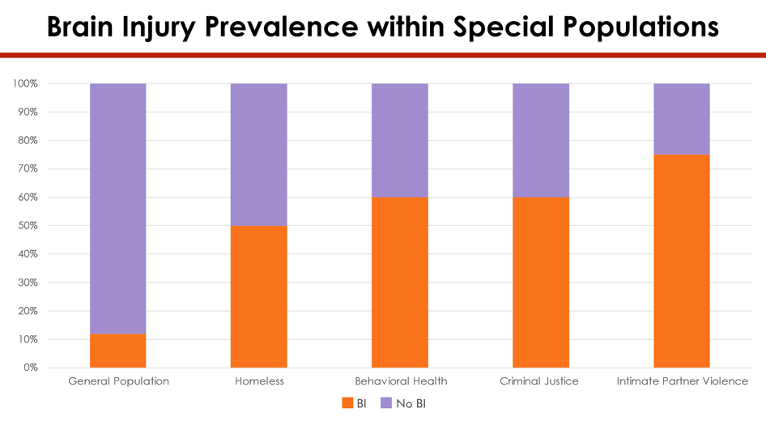
Brain Injury Prevalence within Special Populations
Notes:
Carly
Audience question: when is the brain fully developed/mature? A: 25 for females, 27 for males.
Research tells us that the younger a child sustains an injury the more likely they are to be involved in a cycle of failure. Graphs like this prove this. Explain DOJ project. Not only have we focused on DOJ but homelessness, behavioral health (our FUNDER!) and IPV just dipping our toes into. BI is an explanation-not an excuse! But it is our hope that with proper community supports, trainings, awareness, etc. we can help reduce these numbers.

Slide 20
Suicidality after Brain Injury
Recent committee formed
  NDBIN
  Parents Lead
  ND DHHS Suicide Prevention
  Family members
Notes:
Carly
A very unfortunate impact of brain injury unfortunately is suicidality. One study showed even 7 years following brain injury an individual will have suicidal ideation and this population is extremely impulsive so often does not follow the traditional pattern of suicidality.
One family members consistently reports she just wants people to understand that there is not a monster inside of their head. It is their brain injury lying to them. They need to get inflammation under control and learn to manage symptoms!
One parent of an 18 year old that died by suicide and was very active in sports swears her son had CTE already at the young age of 18.

Slide 21
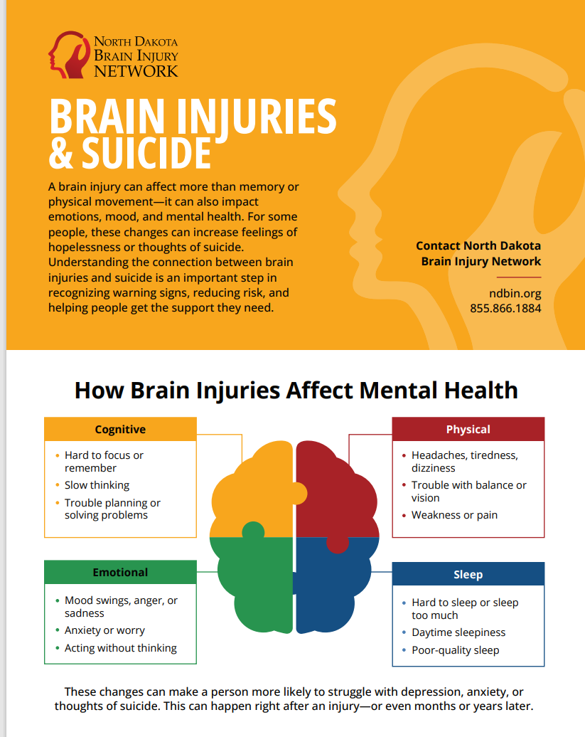
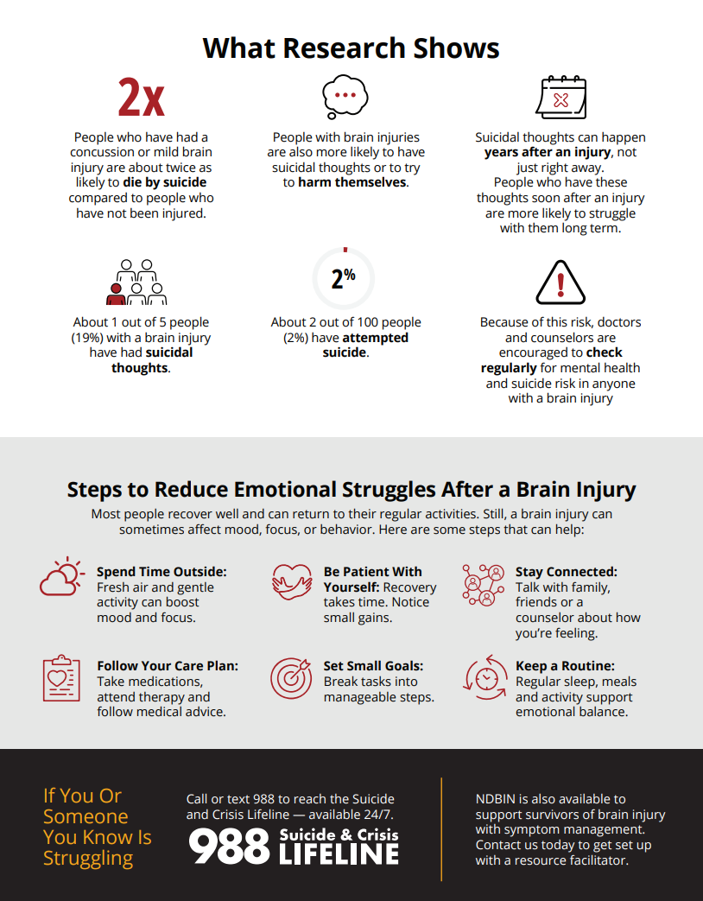
New infographic
Notes:
Carly
This committee developed this infographic that we plan to disperse at events throughout ND in order to spread the word on this important message. I’ll give you a minute to read over some of those stats (if too small read what research shows to them)

Slide 22
Symptom Inventory
Starting point
Strengths and weaknesses
Intended as a placeholder for a full neuropsychological battery
Please help promote getting regular neuropysch batteries! Every 5 years (or after a new injury) is best practice after injury
Notes:
Andrea
At NDBIN we utilize a symptom inventory as starting point for our work with survivors. We have a juvenile and adult version and this helps us narrow in to what is going on with an individual and what referrals should we be making out. When you refer someone to us that is often our first task with them.

Slide 23
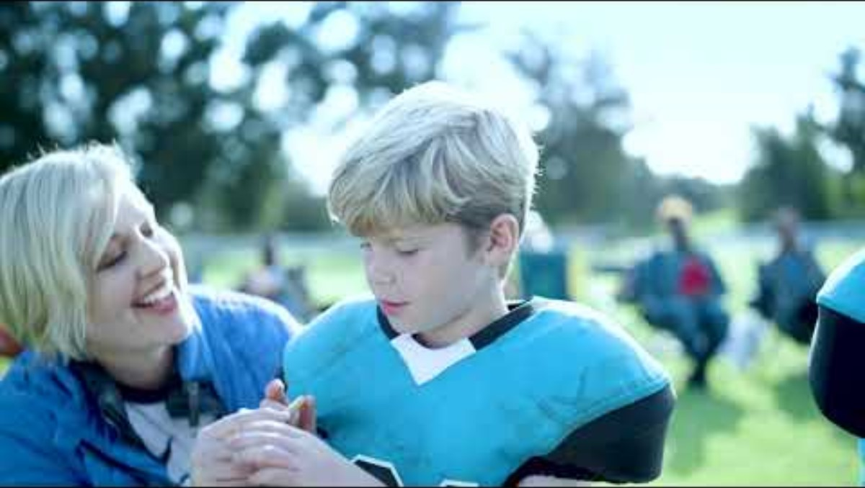
Video 1
Notes:
Carly
This is a great example of why we do what we do at NDBIN! We take a stance that kiddos should not be having any contact during sports until the age of 15. This commercial was developed by the Concussion and CTE foundation. Chris Nowinski is the founder and spoke at our Concussion Symposium several years ago. He and his team and doing amazing research around CTE and you can donate your brain to them if you’d like to be a part of that research! They now have way to see CTE in the living, several years ago it was only visible post-mortem. Exciting advancements are underway but ads like these are a great way to get the attention of parents, coaches, etc.

Slide 24
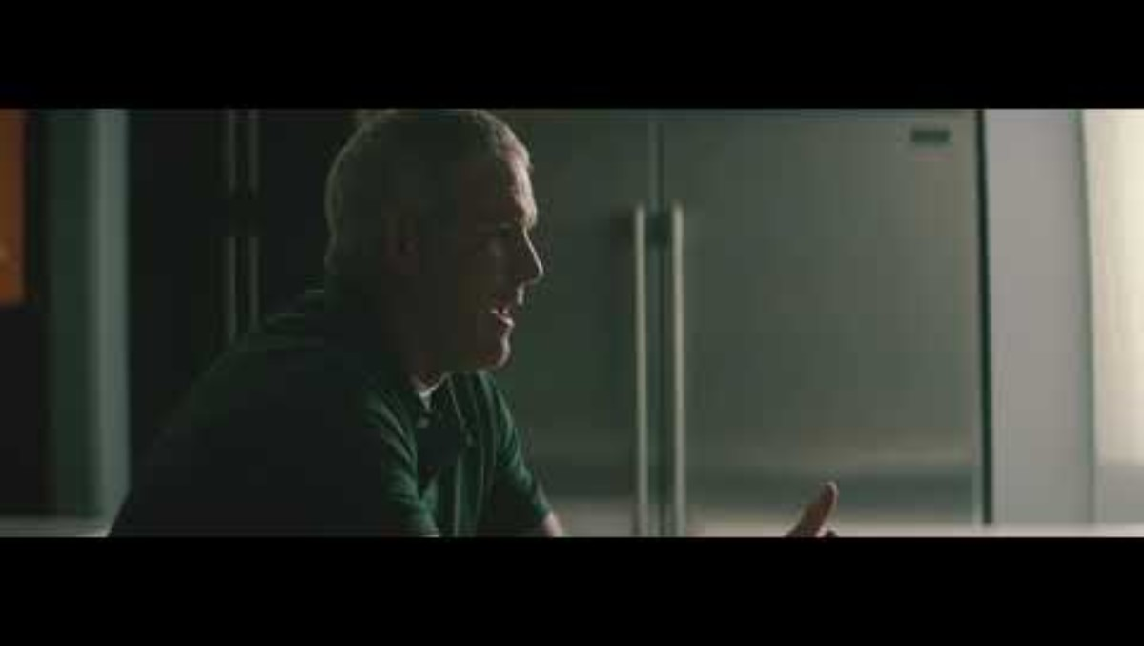
Video 2
Notes:
Carly
Another great example…and we encourage the use of the “Heads up” curriculum which Sanford Health helped roll out in this area fairly recently and they have found that it has reduced concussions ☺

Slide 25
Available Monitoring Practices-ImPACT
ImPACT: Immediate Post-Concussion Assessment and Cognitive Testing
Computerized (20-30 minutes)
Needs comparison or baseline test and post-injury test
Objective data vs. self-reported symptoms
Notes:
Carly
NDBIN intern, Marisa Smith started a project of contacting all of ND’s school districts to see if they currently implement a formal concussion monitoring protocol. Of the 84 she contacted 7 districts use IMPACT, 2 use SWAY and 1 uses SCAT. If you would like contact information on what district is currently using which tool, contact one of us and we can set up a conversation to talk about implementation. If there is anything that NDBIN can do to help implement procedures we will do that.
ImPACT stands for Immediate Post-Concussion Assessment and Cognitive Testing. It is a computerized tool used to help evaluate brain function after a suspected concussion, especially in athletes. The test measures several key areas of cognitive functioning that are commonly affected by brain injury. These include memory—both verbal and visual—attention span, processing speed, reaction time, and impulse control. One of the most important parts of ImPACT testing is the use of baseline testing. This is completed before an injury occurs, often at the beginning of a sports season, and provides a snapshot of an individual’s normal brain function. After a suspected concussion, a post-injury test is administered. Providers compare these results to the baseline to identify any changes or declines in cognitive performance. If no baseline is available, results can be compared to normative data. The test itself is computer-based and typically takes about 20 to 30 minutes to complete. It includes tasks such as remembering word lists or shapes, matching symbols, and responding quickly to visual prompts. It’s important to note that ImPACT is not used on its own to diagnose a concussion. It is one piece of a comprehensive evaluation that also includes symptom reports, clinical exams, and sometimes balance or physical assessments. Healthcare providers use all of this information together to help identify a concussion, monitor recovery, and guide safe return-to-learn and return-to-play decisions. There are also some important limitations to be aware of. Test results can be influenced by factors like effort, fatigue, stress, ADHD, or previous brain injuries. That’s why interpretation by a trained professional is critical. Overall, ImPACT testing is widely used because it provides objective data to support concussion management, rather than relying only on self-reported symptoms.

Slide 26
Available Monitoring Practices-Sway
Sway
Mobile app-based tool
Objectively measures balance
Baseline and after suspected concussion individuals complete repeat assessments over time
Notes:
Carly
NDBIN intern, Marisa Smith started a project of contacting all of ND’s school districts to see if they currently implement a formal concussion monitoring protocol. Of the 84 she contacted 7 districts use IMPACT, 2 use SWAY and 1 uses SCAT. If you would like contact information on what district is currently using which tool, contact one of us and we can set up a conversation to talk about implementation. If there is anything that NDBIN can do to help implement procedures we will do that.
Sway is a mobile app-based tool used to assess balance and cognitive function after a concussion. It’s commonly used in schools, sports programs, and healthcare settings.
Unlike some other tools, Sway uses the accelerometer in a smartphone or tablet to objectively measure balance. The individual holds the device and performs a series of stance positions while the app tracks subtle movements.
Sway also includes cognitive testing, such as reaction time tasks, which helps evaluate how quickly the brain is processing information.
Similar to other concussion tools, Sway works best when there is a baseline assessment completed before an injury. This provides a comparison point for post-injury performance.
After a suspected concussion, individuals complete repeat assessments over time, allowing providers to monitor recovery trends rather than relying on a single snapshot.
One of the key benefits of Sway is that it can be used remotely. Athletes or students can complete tests at home, which supports ongoing monitoring without needing to be in a clinic.
Sway provides objective, quantifiable data on balance and reaction time, which are areas often affected by concussion but may not always be obvious through symptoms alone.
However, like all tools, Sway is not a standalone diagnostic measure. It should be used alongside symptom reporting, clinical evaluation, and other assessments.
Results can also be influenced by factors such as effort, environment, distractions, or improper positioning during the test, so consistency and supervision are important when possible.
Overall, Sway is valuable for tracking recovery over time, supporting safer return-to-learn and return-to-play decisions, and increasing access to concussion monitoring in rural or school-based settings.

Slide 27
Available Monitoring Practices-SCAT
SCAT-Sports Concussion Assessment Tool
Typically used immediately after injury
Quick, standardized, can be done on the sideline
Requires trained professional to administer
Notes:
Andrea
NDBIN intern, Marisa Smith started a project of contacting all of ND’s school districts to see if they currently implement a formal concussion monitoring protocol. Of the 84 she contacted 7 districts use IMPACT, 2 use SWAY and 1 uses SCAT. If you would like contact information on what district is currently using which tool, contact one of us and we can set up a conversation to talk about implementation. If there is anything that NDBIN can do to help implement procedures we will do that.
SCAT stands for the Sport Concussion Assessment Tool. It is a standardized sideline assessment used to evaluate a suspected concussion. The most current version is SCAT6, designed for use by trained healthcare professionals. SCAT is typically used immediately after an injury or within the first 24–48 hours. It is not meant for long-term monitoring on its own. The tool includes several components that provide a comprehensive snapshot of how the brain is functioning after a potential concussion. First, it includes a symptom evaluation, where the individual rates common concussion symptoms like headache, dizziness, nausea, and sensitivity to light or noise. It also includes cognitive screening, such as orientation questions (date, time, location) and memory tasks like recalling word lists. Another component is the neurological screen, which may assess speech, coordination, and basic neurological functioning. Balance is evaluated using a balance examination, where the individual performs different stances while errors are counted. SCAT also includes a coordination test, such as finger-to-nose movements, to check motor control. One important thing to understand is that SCAT provides a structured way to assess multiple domains, but it does not diagnose a concussion by itself. It is most effective when used as part of a broader clinical evaluation and when results are compared over time or alongside other tools. SCAT is widely used in sports because it is quick, standardized, and can be done on the sideline, helping with immediate decision-making—such as removing an athlete from play. However, it does require a trained professional to administer properly, and results can be influenced by the individual’s effort, understanding of questions, or pre-existing conditions. Overall, SCAT is a key tool for early identification and initial assessment, helping ensure that suspected concussions are taken seriously and managed appropriately from the start.

Slide 28
Concussion Tools Comparison-ImPact vs. Sway vs. SCAT
Tool | Purpose | When Used | Setting | Strengths | Limitations | Cost
ImPACT | Cognitive testing | Baseline + post-injury | School, clinic | Tracks memory, reaction time, processing speed | Requires baseline for best use; influenced by effort | Paid – per test or annual subscription (schools/teams often pay per athlete/test)
Sway | Balance + reaction time | Baseline + recovery monitoring | Sideline, home, school | Mobile, remote monitoring, objective data | Requires consistency; environment can affect results | Paid – subscription model (often flat pricing, unlimited users/tests depending on plan)
SCAT | Immediate assessment | Right after injury (0–48 hrs) | Sideline, clinical | Comprehensive, standardized, quick | Not for long-term tracking; requires trained provider | Free – standardized tool (no licensing cost)
Notes:
Carly
This slide compares the three commonly used concussion tools: ImPACT, Sway, and SCAT in North Dakota. Each serves a different purpose in concussion management. To review: Starting with SCAT—this tool is used immediately after a suspected concussion, often right on the sideline or shortly after the injury. It provides a structured way to assess symptoms, cognition, and balance to support removal-from-play decisions. ImPACT is a computer-based cognitive test that is most useful when you have a baseline. It helps identify changes in memory, reaction time, and processing speed after an injury and is often used during recovery. Sway focuses on balance and reaction time, using a mobile device. One of its biggest advantages is that it allows for ongoing monitoring, even remotely, which is especially helpful in school or rural settings. It’s important to understand that no single tool should be used alone. These tools are most effective when combined with clinical evaluation, symptom reporting, and professional judgment. Think of these tools as working together across the timeline of a concussion: SCAT = immediate assessment
ImPACT = cognitive tracking
Sway = balance and recovery monitoring
Using the right tool at the right time helps improve safety, accuracy, and recovery outcomes.
ImPACT is a paid tool. Schools, clinics, or teams typically purchase it either:
Per test (baseline or post-injury), or
Through an annual package or subscription
Costs can vary, but examples include a few dollars per baseline test and higher costs for post-injury testing.
Sway is also a paid platform, but it uses a subscription model rather than per-test pricing:
Organizations pay for access to the platform
Many plans allow unlimited testing and users, which can make it more scalable for large programs
SCAT, on the other hand, is free to use:
It is a standardized assessment tool developed for sideline use
There are no licensing or software costs, but it does require a trained professional to administer properly
When choosing tools, organizations often weigh:
Budget and resources
Number of athletes/students
Need for baseline testing vs. sideline vs. long-term monitoring
A helpful way to think about it:
SCAT = free, immediate assessment
ImPACT = paid cognitive tracking
Sway = paid, flexible monitoring (often more scalable)

Slide 29
Summary
Take-Home Messages:
Youth concussions are frequent and preventable
Monitoring is central to prevention and safer recovery
Rural North Dakota has existing supports and policies
Community collaboration enhances impact
Notes:
Andrea
To wrap up, here are the key take-home messages I want to leave you with. First, youth concussions are both common and preventable. With the right awareness and response, we can reduce risk and improve outcomes. Second, monitoring is central—it’s not just about tracking symptoms, it’s about preventing further harm and supporting safer recovery every step of the way. Third, in rural North Dakota, we already have important supports and policies in place. The foundation is there—we just need to continue building on it and ensuring access. And finally, community collaboration is what makes the biggest difference. When schools, families, healthcare providers, and community organizations work together, we create a stronger, more effective system of care. Ultimately, this is about protecting youth and making sure every student—no matter where they live—has the support they need to recover safely.

Slide 30
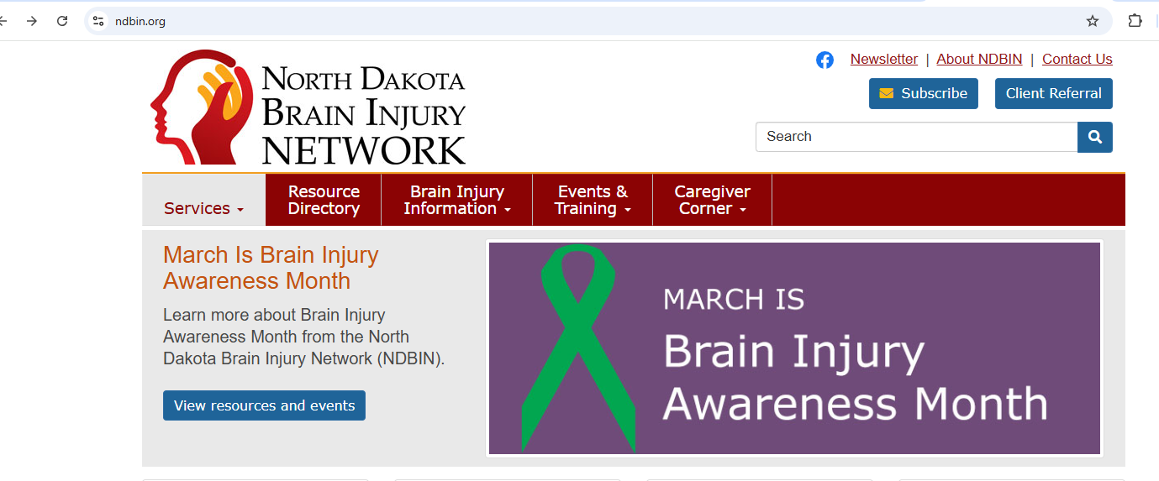
How to refer to NDBIN
Notes:
Carly

Slide 31
Acknowledgments & Resources
North Dakota Brain Injury Network
North Dakota High School Activities Association
Centers for Disease Control & Prevention
Local school athletic departments
Notes:
Andrea

Slide 32
Questions & Discussion
What monitoring tools are working in your community?
What barriers do you face in implementing monitoring?
Notes:
If time/no questions?

Slide 33
References
Key Sources
CDC youth concussion surveillance recommendations. (NCBI)
Rural concussion care disparities. (PubMed)
North Dakota youth concussion prevalence data. (North Dakota Brain Injury Network)
ND concussion legislation and training policy. (ND High School Coaches Association)
Telehealth for rural concussion follow-up. (PubMed)
ImPact Applications, Inc.
Sway Medical

